Slide 1
Are hedge fund managers’ charitable donations strategic?
Sugata Ray
IPC Spring Research Symposium
March, 2019
(Joint work with Vikas Agarwal and Yan Lu)

Slide 2
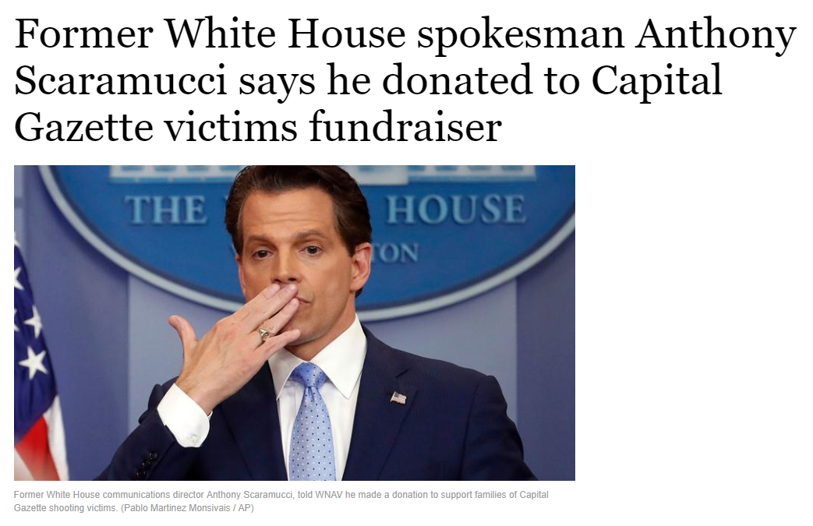
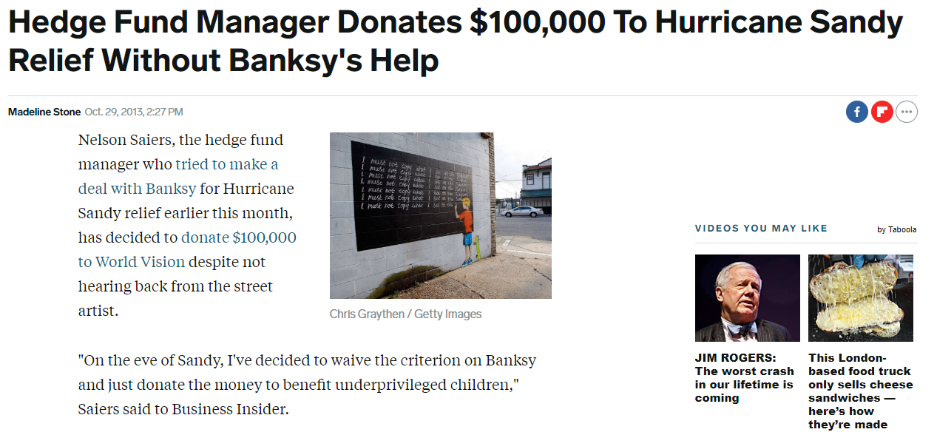
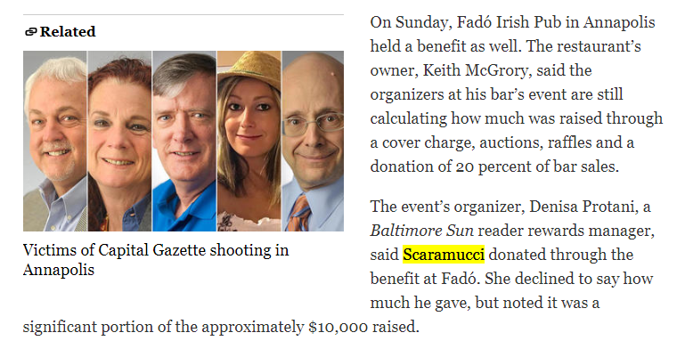
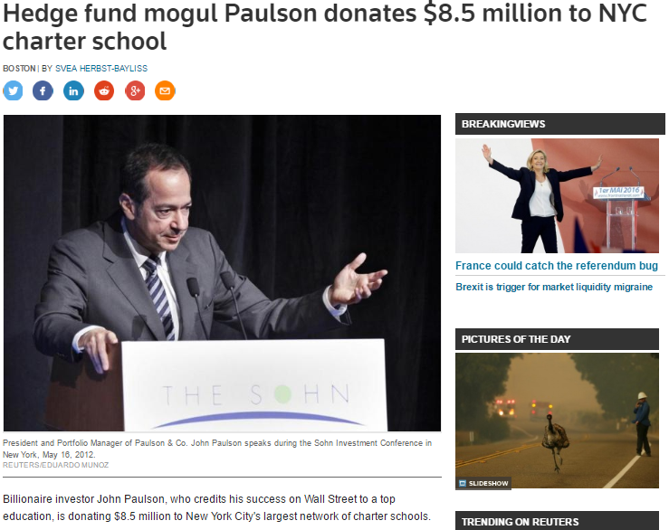
Motivation
Are these donations purely altruistic?
Or do they, in some way, further HF manager’s interests?
I.E. Are hedge fund managers’ charitable donations strategic?
“"I'm worried that I am seeing more and more that suggests that some hedge-fund and private equity managers view charitable donations as a chance to do well for themselves, and forget it is about doing good for others.“
- Senator Charles Grassley (R-IA) ”, 2007

Slide 3
What are some possible strategic motivations?
Donations could be used to increase net flows
  Increase investors’ trust in the fund manager, give them reason to stick by manager through tough times (Gennaioli, Shleifer, and Vishny, 2015; Guiso, Sapienza, and Zingales, 2004)
  Form of advertising (until 2012, HFs banned from advertising, even afterwards, very limited advertising)
Donations could be used to increase returns
  Charitable events/board/etc. could be a networking platform to get ideas from other donors

Slide 4
How do we test for this?
Hard to directly observe intentions of fund managers who donate
Instead, we observe determinants and effects of donations
  Are managers who need to increase flows/improve performance donate more likely to donate?
  Do these donations work? I.e. do flows/performance improve?
  Are the results stronger for certain types of donations, which are more likely to be strategic a priori?
Using these indirectly observed links between donations and fund circumstances, we build a case for (at least certain) donations being strategic

Slide 5
Data
Hedge fund performance and characteristics: Lipper TASS
Charitable donations: NOZA
Merge the data at the fund manager level using information on names and addresses
Final dataset is a panel covering 1,126 funds and 667 managers from Jan 1994 to June 2016 who have a total of 6,642 charitable donations during the period

Slide 6


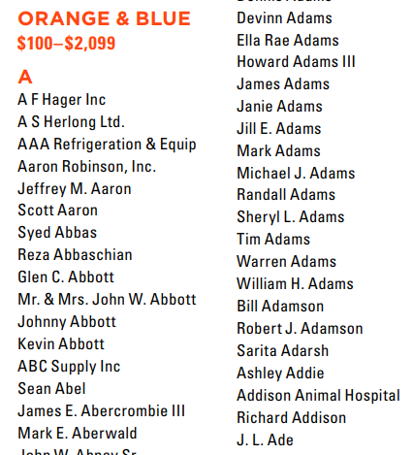
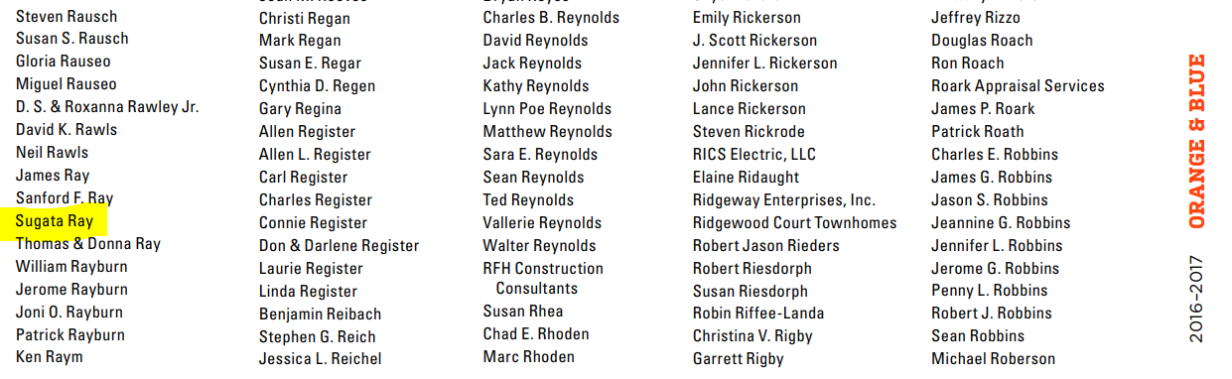
Donation Data and Timeline
Many charities release annual reports with non-anonymous donors along with donation size band
NOZA collates this data and adds further information regarding donors from public records (e.g addresses)
  NOZA is generally used by development offices for fundraising purposes
We name match NOZA data with TASS manager data, and use address data to refine matches
Donation period spans 1 year annual report period (mostly calendar or July→June); determinants before this, effects after, robustness
Jan 2011
Jan 2012
Jan 2013
Jan 2014
Jan 2015
Jan 2016
Determinants
Donation
Effects

Slide 7
Summary statistics of donations
Variable | Obs | Mean | Std. Dev. | 25th pctile | 75th pctile
amount | 4,852 | 81,856 | 767,538 | 500 | 7,500
amount(>7.5K) | 1,196 | 325,913 | 1,520,634 | 17,500 | 75,000
normalized amount(>7.5K) | 1,196 | 0.400 | 0.950 | 0.006 | 0.072
Focus on the large gifts (>$7500, 75th percentile) as they are more likely to matter
Normalized amount = large donation/last year’s annual management fee
0.072 means that they are giving away 7.2% of their annual management fees (40% of the fees for the average amount of $325,913 conditional on amount greater than $7,500, but this is skewed by larger gifts)
Notes:
7500 is the cutoff for large donations.

Slide 8
Determinants analysis
Donation_{t} = β perf_{t-12→t-1} + χ flows_{t-12→t-1} + δ fund-char. + …
 | Return | Style-adj. Return | Alpha | Sharpe
Return _{t-1, t-12} | −24.92*** | −25.67*** | −26.41*** | −0.05
 | (–4.99) | (–6.24) | (–2.81) | (–0.89)
Flow _{t-1,,t-12} | –6.99*** | –7.67*** | –9.79*** | –7.80***
 | (–3.62) | (–3.79) | (–3.42) | (–3.87)
Management Fee | 1.18*** | 1.17*** | 1.10*** | 1.18***
 | (4.21) | (4.32) | (3.84) | (4.01)
Incentive Fee | 0.15*** | 0.14*** | 0.14*** | 0.14***
 | (2.94) | (2.78) | (2.69) | (2.99)
High–water Mark | 2.24*** | 2.28*** | 1.99** | 2.32**
 | (2.58) | (2.63) | (2.51) | (2.44)
Lockup Period | –0.07** | –0.07** | –0.06* | –0.07**
 | (–2.26) | (–2.18) | (–1.88) | (–2.20)
Closed to Invest | –1.60* | –1.60* | –1.40* | –1.61*
 | (–1.86) | (–1.91) | (–1.69) | (–1.80)
Other fund-level controls; Errors double-clustered (fund and month level)
R-squared | 0.21 | 0.21 | 0.19 | 0.20
N | 79187 | 79187 | 57333 | 79161

Slide 9
Determinants analysis
Flow and Return non-linearities – only worst performers more likely to donate
 | Return | Style-adj. Return | Alpha | Sharpe
Performance _{t–1,t–12}_Quartile1 | 0.90*** | 0.65*** | 0.40** | 0.87***
 | (3.89) | (2.76) | (2.04) | (4.00)
Performance _{t–1,t–12}_Quartile2 | –0.09 | 0.01 | 0.01 | 0.01
 | (–0.60) | (0.11) | (0.06) | (0.03)
Performance _{t–1,t–12}_Quartile4 | 0.20 | –0.01 | –0.23 | –0.20
 | (0.77) | (–0.05) | (–0.77) | (–0.74)
Flow _{t–1,t–12}_Quartile1 | 0.71*** | 0.75*** | 0.75*** | 0.70***
 | (2.87) | (3.06) | (2.70) | (2.80)
Flow _{t–1,t–12}_Quartile2 | 0.02 | 0.04 | –0.04 | 0.01
 | (0.07) | (0.20) | (–0.13) | (0.05)
Flow _{t–1,t–12}_Quartile4 | –0.31 | –0.31 | 0.88 | –0.29
 | (–0.72) | (–0.73) | (1.39) | (–0.69)
Controls from before | Yes | Yes | Yes | Yes
Other fund-level controls; Errors double-clustered (fund and month level)
R-squared | 0.31 | 0.30 | 0.30 | 0.31
N | 79187 | 79187 | 57333 | 79161

Slide 10
Determinants analysis
Baseline model – Note the higher R²
 | Return | Style-adj. Return | Alpha | Sharpe
Perf. _{t–1, t–12}_Quartile1 | 0.99*** | 0.77*** | 0.38** | 0.99***
 | (4.88) | (3.93) | (2.14) | (5.13)
Flow _{t–1, t–12}_Quartile1 | 0.47*** | 0.53*** | 0.50*** | 0.48***
 | (2.64) | (2.90) | (2.65) | (2.64)
Management Fee | 1.40*** | 1.39*** | 1.28*** | 1.39***
 | (4.15) | (4.13) | (3.84) | (4.24)
Incentive Fee | 0.18*** | 0.17*** | 0.17*** | 0.18***
 | (3.73) | (3.57) | (3.35) | (3.79)
High–water Mark | 2.94** | 3.03** | 2.52** | 2.93**
 | (2.48) | (2.49) | (2.41) | (2.56)
Lockup Period | –0.08** | –0.08** | –0.07** | –0.08**
 | (–2.52) | (–2.48) | (–2.13) | (–2.51)
Closed to Invest | –2.15** | –2.06** | –1.79* | –2.15**
 | (–1.97) | (–1.98) | (–1.76) | (–2.00)
Other fund-level controls; Errors double-clustered (fund and month level)
R-squared | 0.26 | 0.25 | 0.23 | 0.26
N | 79187 | 79187 | 57333 | 79161

Slide 11
Recap and motivating effects analysis
So funds doing poorly more likely to donate
  First hint that something strategic might be going on
  Normally, we would expect funds that are doing better to donate
  Also, tax benefits from donation would be most valuable to well-performing managers
The poorly performing managers would benefit most from added net flows + improved returns
Additionally, the fund characteristics of note that predict donations also correlate with benefitting most from added net flows [higher fees, HWM, lower lockup and not being closed to new investment]
So, what are the *effects* of the donations?

Slide 12
Effects – matched sample analysis
Match each donating fund to a non-donating fund in the same period with the closest trailing 12-month performance and flow (50% weight on each)
Use this sample or donating (treated) and non-donating (control) funds to estimate the predictive effect of the donation on future performance [use propensity score matching to check robustness]
Do diff-in-diff analyses to test for effects of the donation
  Perform univariate analyses for clarity of interpretation
  Performance a regression including fund months 12 months before and after the donation period for both donating and matched fund

Slide 13
Effects: y_{t+12 –} y_{t-12} = β I_{donation} + …. matched sample I
 | Flow |  | Return |  | Style–adj. Return |  | Alpha |  | Sharpe
 | Before | After | Before | After | Before | After | Before | After | Before | After
Donating | 0.65 | –0.10 | 0.66 | 0.59 | –0.11 | –0.21 | 0.45 | 0.33 | 0.39 | 0.25
Non–donating | 0.69 | –0.81 | 0.65 | 0.49 | –0.10 | –0.05 | 0.42 | 0.41 | 0.39 | 0.31
DID | 0.75*** |  | 0.09 |  | –0.15 |  | –0.11 |  | –0.06
After donations, the funds’ flows are higher, compared to matched sample [they experience lower net outflows] – also works for multivariate regressions (unpresented)
There does not appear to be a statistically significant effect on performance

Slide 14
Story so far and additional tests
Poorly performing funds, and funds with most to gain from additional inflows (based on fund characteristics) more likely to donate
Donating funds receive significantly higher net inflows (really experience lower net outflows) than matched, non-donating funds
Both consistent with strategic motives behind donations

Slide 15
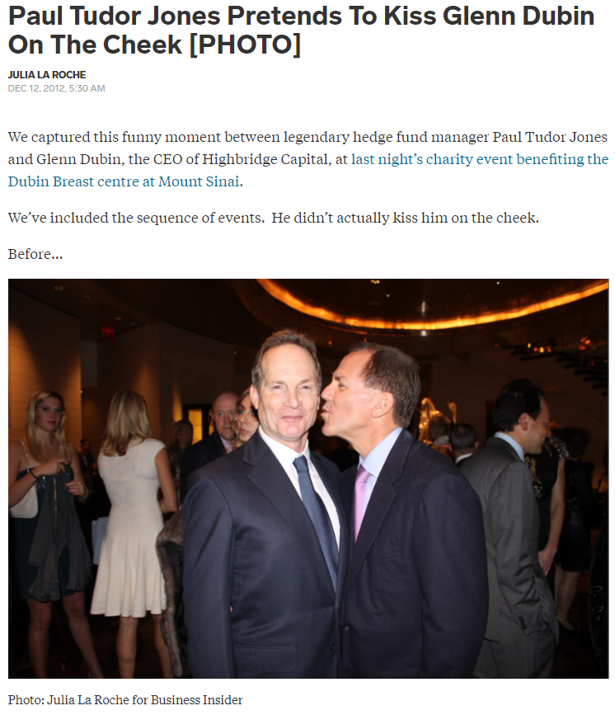
Story so far and additional tests (cont’d)
Next, we will test if these effects are stronger for donations that are, a priori, more likely to be strategic in nature depending on recent circumstances
  One-off donations, compared to recurring gift – note that recurring gifts may still be strategic, but are unlikely to depend on recent fund circumstances
  Gifts to charities that other HF managers also donate to (charities with more than the median number of HF donors)
  Gifts to charities that hold events catering to the HF community (charities with a HF manager making a donation earmarked for an event)
 | Nonrecurring (45.3%) | Focal (43.3%) | Event (14.5%)
Nonrecurring | 1
Focal | 0.117 | 1
Event | 0.012 | 0.016 | 1

Slide 16
Determinants analysis (Sharpe Ratio as performance measure only – others same)
All the results concentrated in one-off sample
 |  | One-off donations | Recurring donations | Difference
Perf. _{t–1, t–12}_Quartile1 |  | 1.20*** | 0.18 | 1.02***
 |  | (6.40) | (0.92)
Flow _{t–1, t–12}_Quartile1 |  | 0.64** | 0.01 | 0.63**
 |  | (2.56) | (0.05)
Management Fee |  | 2.20*** | 0.39** | 1.81***
 |  | (4.71) | (2.23)
Incentive Fee |  | 0.25*** | –0.03 | 0.28***
 |  | (6.09) | (–0.73)
High–water Mark |  | 6.10*** | 0.17 | 5.93***
 |  | (2.95) | (0.39)
Lockup Period |  | –0.11*** | 0.01 | -0.12***
 |  | (–3.23) | (0.34)
Closed to Invest |  | –4.15*** | –0.47 | -3.68**
 |  | (–3.06) | (–0.97)
Other fund-level controls; Errors double-clustered (fund and month level)
R-squared |  | 0.40 | 0.07
N |  | 78323 | 77838

Slide 17
Effects: Univariate effects presented (multivariate results are consistent)
Flows only increase for One-off donations
One-Off | Flow |  | Return |  | Style–adj. Return |  | Alpha |  | Sharpe
 | Before | After | Before | After | Before | After | Before | After | Before | After
Donating | 0.67 | –0.13 | 0.48 | 0.46 | –0.14 | –0.24 | 0.39 | 0.27 | 0.40 | 0.19
Non–donating | 0.73 | –1.10 | 0.56 | 0.58 | –0.11 | –0.11 | 0.43 | 0.31 | 0.39 | 0.28
DID | 1.03*** |  | –0.04 |  | –0.10 |  | 0.00 |  | –0.10
Recurring | Flow |  | Return |  | Style–adj. Return |  | Alpha |  | Sharpe
 | Before | After | Before | After | Before | After | Before | After | Before | After
Donating | 0.81 | –0.34 | 0.73 | 0.53 | –0.17 | –0.18 | 0.52 | 0.51 | 0.36 | 0.26
Non–donating | 0.82 | 0.18 | 0.66 | 0.54 | –0.10 | –0.07 | 0.45 | 0.55 | 0.36 | 0.30
DID | –0.51 |  | –0.08 |  | –0.04 |  | –0.11 |  | –0.04

Slide 18
Determinants analysis (Sharpe Ratio as performance measure only – others same)
All the results concentrated in Focal Charity sample
 |  | Focal Charities | Non-Focal Charities | Difference
Perf. _{t–1, t–12}_Quartile1 |  | 1.33*** | –0.09 | 1.42***
 |  | (5.23) | (–0.50)
Flow _{t–1, t–12}_Quartile1 |  | 0.61*** | 0.04 | 0.57*
 |  | (2.99) | (0.19)
Management Fee |  | 1.56*** | 0.34* | 1.22***
 |  | (4.61) | (1.73)
Incentive Fee |  | 0.30*** | –0.02 | 0.32***
 |  | (6.41) | (–0.71)
High–water Mark |  | 2.35* | –0.07 | 2.42*
 |  | (1.92) | (–0.19)
Lockup Period |  | –0.20** | –0.01 | -0.19**
 |  | (–2.51) | (–0.28)
Closed to Invest |  | –3.91*** | –0.36 | -3.55***
 |  | (–3.59) | (–0.87)
Other fund-level controls; Errors double-clustered (fund and month level)
R-squared |  | 0.41 | 0.05
N |  | 77688 | 78481

Slide 19
Effects: Univariate effects presented (multivariate results are consistent)
Flows only increase for Focal Charities
Focal Charity | Flow |  | Return |  | Style–adj. Return |  | Alpha |  | Sharpe
 | Before | After | Before | After | Before | After | Before | After | Before | After
Donating | 0.30 | 0.03 | 0.40 | 0.71 | –0.07 | –0.27 | 0.34 | 0.57 | 0.61 | 0.82
Non–donating | 0.31 | –0.85 | 0.51 | 0.78 | –0.08 | –0.21 | 0.21 | 0.49 | 0.59 | 0.79
DID | 0.89*** |  | 0.04 |  | –0.07 |  | –0.05 |  | 0.01
Non-focal Charity | Flow |  | Return |  | Style–adj. Return |  | Alpha |  | Sharpe
 | Before | After | Before | After | Before | After | Before | After | Before | After
Donating | 0.77 | –0.25 | 0.68 | 0.52 | –0.08 | –0.17 | 0.41 | 0.38 | 0.41 | 0.29
Non–donating | 0.97 | 0.09 | 0.65 | 0.63 | –0.03 | 0.02 | 0.43 | 0.44 | 0.41 | 0.33
DID | –0.14 |  | –0.14 |  | –0.14 |  | –0.04 |  | –0.04

Slide 20
What about the channel? We look at Charities which have received donations by HF managers earmarked for events
 | Event | Non-Event
Performance _{t-1, t-12}_Quartile1 | 4.78*** | ‒0.00
 | (2.70) | (‒0.01)
Flow _{t-1, t-12}_Quartile1 | 4.95*** | ‒0.09
 | (2.80) | (‒0.50)
Fund Characteristics | Yes | Yes
Cluster at Fund and Month | Yes | Yes
R-squared | 0.41 | 0.07
N | 78349 | 78864
Effects
 | Flow
Donate | 0.02
 | (0.07)
After | ‒1.54***
 | (‒5.23)
Donate×After | 0.76**
 | (2.11)
Event | 0.41
 | (1.52)
Event×Donate | 0.08
 | (0.28)
Event×After | 0.21
 | (0.72)
Event×Donate×After | 0.64*
 | (1.76)
Fund Characteristics | Yes
Cluster at Fund and Year | Yes
R-squared | 0.039
N | 4138
Determinants

Slide 21
Mortality Risk – do donating funds experience less mortality than their matched non-donating peers?
 | Logit | Cox
Donate | ‒0.555** | 0.729*
 | (‒3.81) | (‒1.87)
Management Fee | ‒0.035 | 1.128
 | (‒0.54) | (‒0.85)
Incentive Fee | 0.023* | 0.997
 | (‒2.12) | (‒0.18)
High Water Mark | ‒0.053 | 0.86
 | (‒0.31) | (‒0.59)
Lock Up Period | ‒0.013 | 1.012
 | (‒1.55) | (‒0.98)
Closed to Investment | 0.060 | 0.624
 | (‒0.24) | (‒1.15)
Other fund controls, errors clustered at fund and month level | Yes | Yes
R-squared | 0.134 | 0.205
N | 23863 | 23863

Slide 22
Economics of donations
Is this a good deal?
  The median larger donation is $17,500 and nets the median fund with $34MM in AUM a median annual reduction in outflows of 9%. This in turn increases management fees by 9% × $34MM × 1.5% (the median management fee) = $45,900
  It appears that these donations are a very good deal, and that is without even factoring in incentive fees and both management and incentives fees from subsequent years and longer fund life.
Too bad the deal is not scalable and only works for smaller funds … also, token gifts do not appear to work as well
 | Large Fund Size | Small Fund Size
Large donations (above median|>$7,500) | 0.64 | 1.57**
Small donations (below median|<$7,500) | 0.67 | 0.46

Slide 23
Conclusions
Evidence consistent with strategic intent behind some charitable donations
  Donations are used to create goodwill among investors to attract flows – a way to gain trust and mitigate operational risk concerns
  Fund managers donate in tough circumstances and when flows mean more to them
  One-off donations, and donations to charities popular among the HF community, and charities that hold events catering to the HF community appear to be particularly strategic, as expected
Investors should be cognizant of this
Charities should be cognizant of this

Slide 24
Literature review - CSR
Opposing views on the impact of CSR on the firm value
  Value-enhancing view
    Positive impact due to the enhancement of reputation with different stakeholders and regulatory agencies (Navarro, 1988; Brown, Helland, and Smith, 2006)
  Value-destroying view
    Negative impact as managers benefit themselves at the expense of the shareholders (Masulis and Reza, 2014)
HF managers donate their own money so
  Fewer agency problems
  But higher fees accrue directly to managers, so potential to donate for business interests more acute

Slide 25
Literature review - Donations
Large literature on why people donate to charity
  Matching gifts increase the chances of donation (Karlan and List, 2007)
  Social pressure (Dellavigna, List, and Malmendier, 2012)
Little work on the effects of donations on the donors
We contribute by showing how donors may benefit their business interests through donations

Slide 26
Effects analysis, matched sample regression
 | Flow | Return | Style–adj. Return | Alpha | Sharpe
Donate | 0.03 | 0.02 | –0.02 | 0.04 | 0.01
 | (0.12) | (0.21) | (–0.18) | (0.69) | (0.36)
After | –1.51*** | –0.06 | 0.05 | –0.01 | –0.09*
 | (–5.11) | (–0.50) | (0.44) | (–0.11) | (–1.69)
Donate×After | 0.75** | –0.09 | –0.14 | –0.10 | –0.06
 | (2.07) | (–0.79) | (–1.23) | (–1.40) | (–0.97)
Controls & Ints. | Yes | Yes | Yes | Yes | Yes
Clustering | Two-way (Fund and Time)
R-squared | 0.038 | 0.004 | 0.008 | 0.011 | 0.040
N | 4098 | 4792 | 4806 | 4262 | 1248

