Slide 1
12th Annual Hedge Fund Research Conference 17th Jan 2020
Hedge Fund Hold’em
Yan Lu- University of Central Florida
Sandra Mortal- University of Alabama
Sugata Ray- University of Alabama

Slide 2
Personal pursuits → Professional value destruction
Golf (Biggerstaff, Cicero, and Puckett, 2017, MS)
Accolades (Malmendier and Tate, 2009, QJE)
Marriage/Divorce (Lu, Ray, Teo, 2016, JFE)
Notes:
Peter Lynch retired from his position as manager of Magellan Fund in 1990 after one of the most successful runs in stock market history. During his remarkable 13-year run, Lynch produced an annualized rate of return of 29.2%, beating the market at large by 13.4% per year ..
Walter Clyde "Puggy" Pearson (January 29, 1929 – April 12, 2006) was an American professional poker player. He is best known as the 1973 World Series of Poker Main Event winner.^{[1]}
William H. Miller III is an American investor, fund manager, and philanthropist. He served as the chairman and chief investment officer of Legg Mason Capital Management as well as the principal portfolio manager of the Legg Mason Capital Management Value Trust. He now runs a fund based management company known as Acunari and is the portfolio manager of the former Legg Mason Opportunity Trust mutual funds, now housed at his own firm Miller Value Partners.

Slide 3
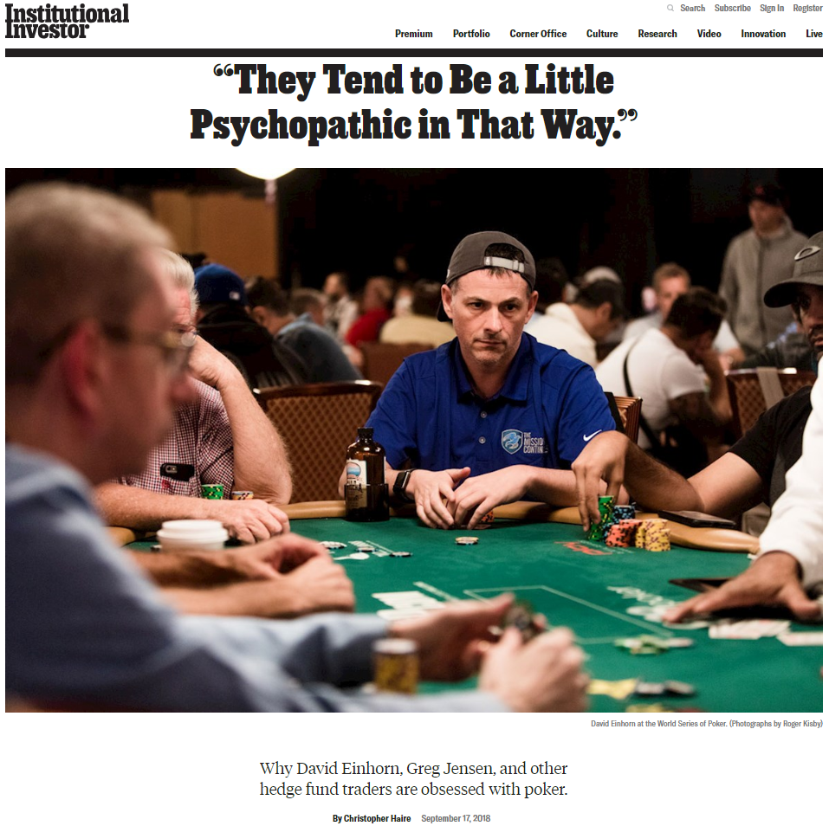
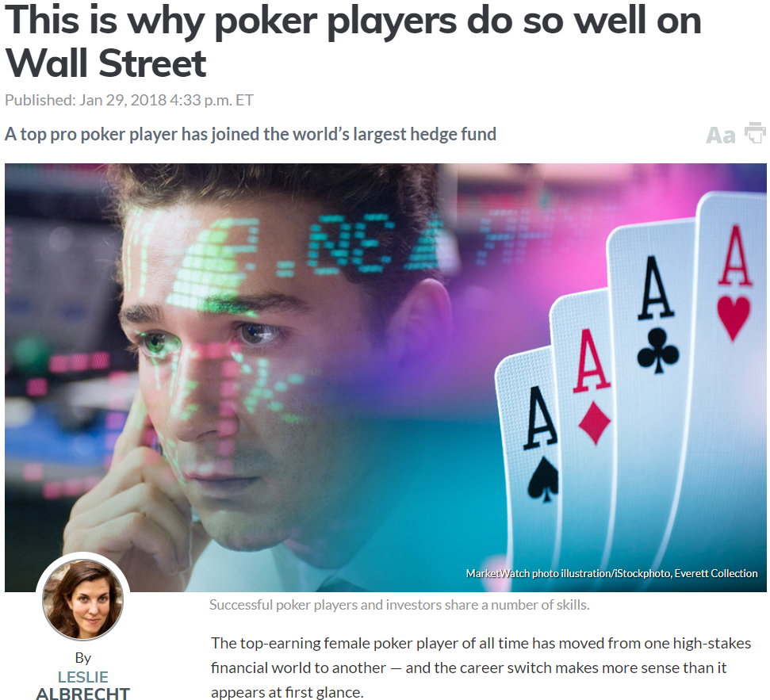
In contrast, poker is perceived to be correlated with productivity in investing
“Investing in a poker game and investing in stocks, at least the way I do it, is a very similar skillset. ” – D. Einhorn
“The stock market reminds me of a stud poker game.”- Peter Lynch
Poker players getting into HF space
HF managers having success in poker
Training for traders using poker
Notes:
David M. Einhorn (born November 20, 1968) is an American investor, hedge fund manager, and philanthropist. He is the founder and president of Greenlight Capital, a "long-short value-oriented hedge fund."^{[2]} Famous for shorting Lehman Brothers
SIG stands for Susquehanna International Group
Vanessa Selbst, a 33-year-old three-time World Series of Poker (WSOP) winner, recently took a job with Bridgewater, the world’s largest hedge fund, she announced in a Facebook post.

Slide 4
Questions in Our Study
Resolve this tension:
Is there actually a link between poker skill and hedge fund management skill?
Is poker yet another distracting personal pursuit?
Or perhaps do poker players take excessive risk at in their funds?
If there is any relationship between poker and fund mgmt, how do investors respond to demonstrated evidence of poker playing/skill from their hedge fund managers?
And why do we care?
Clear expectations in industry given the anecdotal evidence
Are these expectations borne out by the data?
Are asset allocators accurately using signals

Slide 5
Tie-in with literature
Links between personal and professional life
Distractions
Golf (Biggerstaff, Cicero, and Puckett, 2017, MS)
Accolades (Malmendier and Tate, 2009, QJE)
Marriage/Divorce (Lu, Ray, Teo, 2016, JFE)
Risk preferences
Mortgages (Cronqvist, Makhija, Yonker, 2012 JFE; Pool, Stoffman, Yonker, Zhang, RFS)
Cars (Brown, Lu, Ray, Teo, 2018, JF)
Alternative signals for skill
Performance in other funds (Choi, Kahraman, and Mukherjee, 2016 JF)
Educational background/IQ (Chevalier and Ellison, 1999 JF; Chaudhuri et al, 2019 Mgmt Sci Forthcoming, Grinblatt, Keloharju, & Linnainmaa, 2012 JFE )
Personal real estate performance (Cheng, Raina, Xiong, 2014 AER)
Capital allocation/formation literature

Slide 6
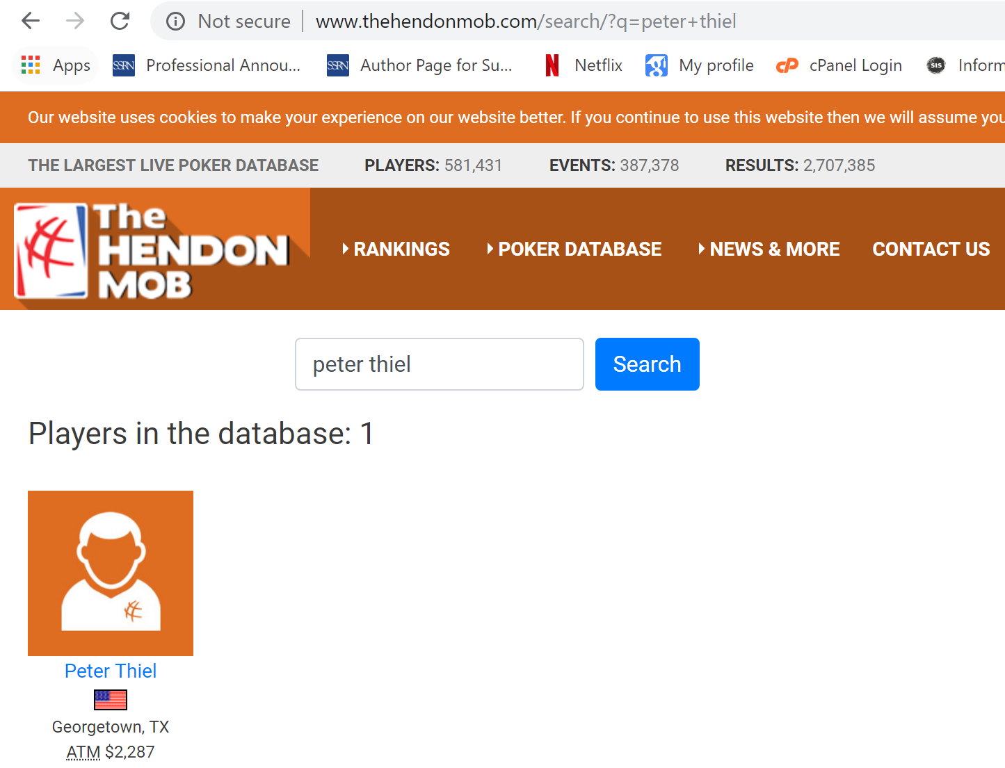
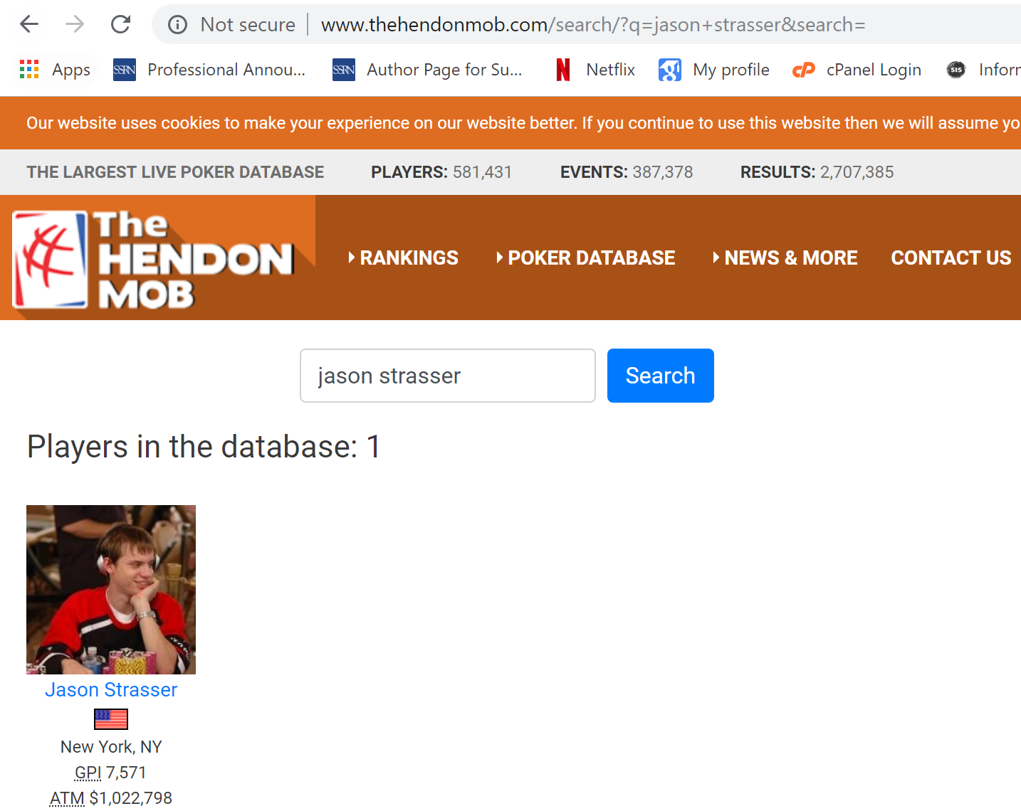
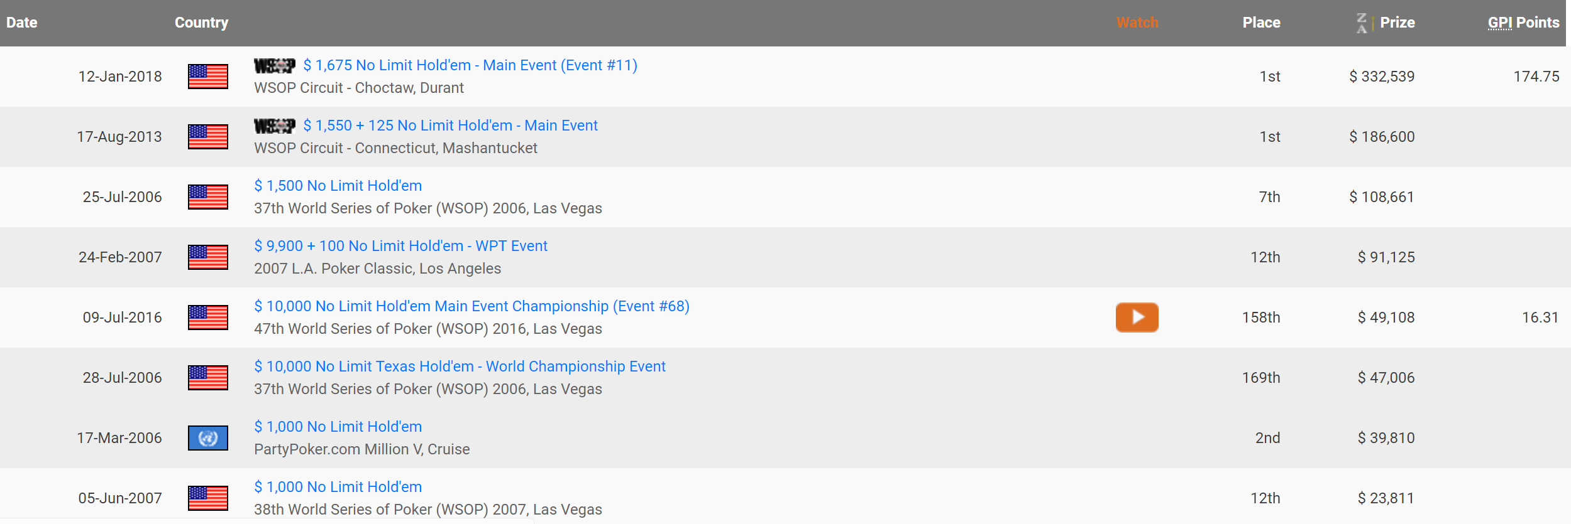
Data
TASS Commercial HF dataset
Hendon Mob Tournament Database
13F quarterly holding data
Notes:
Peter Andreas Thiel (/tiːl/; born October 11, 1967) is an American entrepreneur, venture capitalist, philanthropist, political activist, and author. He is a co-founder of PayPal, Palantir Technologies and Founders Fund. After the sale of PayPal, he founded Clarium Capital, a global macrohedge fund.
Caption Management, LLC is an investment management firm founded in 2012 by Jason Strasser and William Cooper
trades equity options—mostly technology and consumer companies—in an attempt to profit from volatility, according to people with knowledge of the strategy. It’s known as a “Vol Arb” fund in hedge fund industry lingo.

Slide 7
How does a poker tournament work?
Players pay a buy-in (typically expressed as $XX+$YY)
Where $XX goes towards prize pool and
$YY goes to the “house”
An example of a buy-in might be $100+$15
If 50 people enter such a tournament, $5,000 goes to prize pool and $750 goes to the house
They are given chips and play poker, with increasing blinds and antes forcing the action, until only one player remains – the order in which they go out determines placing (so last player left is 1st, 2nd last player left is 2nd, etc.)
Payouts go to roughly top 10% of finishers with lions share going to top finishers. We only observe data on the players who get a payout (or “cash”) in a tournament

Slide 8
Summary Statistics
Managed by 2191 and 182 managers, respectively
 | No poker win | Poker Win(s) | Difference
N | 3017 | 220
Management Fee (%) | 1.43 | 1.44 | 0.01
Incentive Fee (%) | 14.70 | 14.33 | -0.37
High Water Mark | 0.65 | 0.63 | -0.02
Proportion with Lockups | 0.30 | 0.14 | -0.16
Mean Lockups (days) | 262.96 | 301.31 | 38.35
Redemption Period (days) | 50.36 | 44.75 | -5.61
Fund Age(years) | 3.02 | 3.72 | 0.70***
Time series data
Raw return (%) | 0.58 | 0.67 | 0.09***
Alpha (%) | 0.23 | 0.34 | 0.11***
Flow (%) | 1.34 | 1.57 | 0.23*
Total Risk (%) | 3.20 | 3.06 | -0.14
Idiosyncratic Risk (%) | 2.21 | 2.06 | -0.15
Mean Assets (MM$) | 228.13 | 234.83 | 6.70

Slide 9
Summary Stats for Poker Tournaments
Variable | Obs. | Mean | Std. Dev.
Prize ($) | 579 | 7,739 | 33,773
Media (Dummy) | 579 | 0.045 | 0.207
Big Event (Dummy) | 579 | 0.226 | 0.419
# of Entries | 574 | 799 | 1,451
Buy-In ($) | 575 | 1,872 | 3,556
# Wins | 182 | 3.18 | 2.96

Slide 10
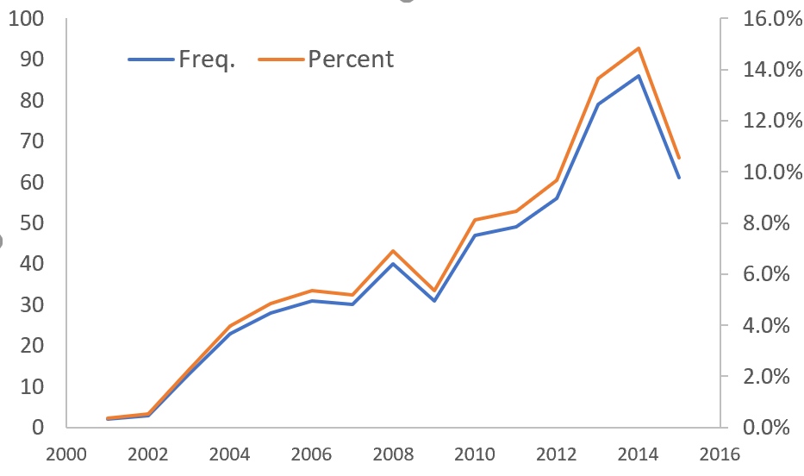
Summary Statistics II
579 wins, for 182 managers, managing 220 funds
Coverage in Hendon Mob gets better over time

Slide 11
Regression Analysis (1 = win, 0 = nowin)
But we don’t see all the entries … just the wins.
Lifetime/TTM | Cross-sectional |  | Panel
Return | 0.510*** |  | 0.245***
 | (4.04) |  | (3.26)
Alpha |  | 0.414*** |  | 0.305***
 |  | (4.00) |  | (3.16)
Flow | -0.069** | -0.068* | -0.034*** | -0.021
 | (-2.33) | (-1.79) | (-2.95) | (-1.03)
Total Risk | -0.007 |  | 0.063
 | (-0.14) |  | (0.60)
Idio. Risk |  | -0.069 |  | -0.073
 |  | (-0.91) |  | (-0.39)
Control Variables | Yes | Yes | Yes | Yes
Year Dummies | NA | NA | Yes | Yes
Strategy Dummies | Yes | Yes | Yes | Yes
Cluster by Fund | NA | NA | Yes | Yes
Cluster by Time | NA | NA | Yes | Yes
R-squared | 0.083 | 0.082 | 0.066 | 0.080
N | 1,706 | 1,372 | 129,038 | 91,736

Slide 12
Indications of greater poker skill Bigger buy-ins, more entries, higher $ prizes, more wins r,α,flow for winner vs non-winners – among the winners…
 | Dollar Prize won |  |  |  | Number of entries
 | >median | <=median | Difference |  | >median | <=median | Difference
Return | 0.86 | 0.48 | 0.38** |  | 0.82 | 0.53 | 0.29**
Alpha | 0.53 | 0.29 | 0.24** |  | 0.55 | 0.23 | 0.32**
Flow | 3.43 | 0.81 | 2.62*** |  | 3.59 | 0.70 | 2.89***
 | Buy-in |  |  |  | Number of wins
 | >median | <=median | Difference |  | >median | <=median | Difference
Return | 0.74 | 0.58 | 0.16* |  | 0.88 | 0.46 | 0.42**
Alpha | 0.54 | 0.24 | 0.30** |  | 0.50 | 0.32 | 0.18*
Flow | 3.08 | 1.16 | 1.92*** |  | 2.83 | 1.05 | 1.78***

Slide 13
Funds with managers winning before they start fund *also* outperform
Compare funds which win before inception to other funds in same strategy started at same time with no wins before inception
 | Win before inception | No win before inception | Difference
Returns | 0.77 | 0.21 | 0.56***
Alpha | 0.50 | 0.19 | 0.31***
Size at inception ($MM) | 46.78 | 75.46 | -26.68***

Slide 14
Why Do They Outperform?
 | Fundamental |  | Others
 | Return (1) | Alpha (2) | Return (3) | Alpha (4)
PT Win | 0.539*** | 0.383*** | 0.215 | 0.207
 | (3.77) | (2.72) | (1.46) | (1.20)
Avg. Flow | 0.017** | 0.044*** | 0.004 | -0.001
 | (2.09) | (3.36) | (0.75) | (-0.06)
Total Risk | 0.058*** |  | -0.006
 | (3.17) |  | (-0.38)
Idio. Risk |  | 0.016 |  | -0.041
 |  | (0.62) |  | (-1.53)
Control Variables | Yes | Yes | Yes | Yes
Strategy Dummies | Yes | Yes | Yes | Yes
R-Squared | 0.094 | 0.084 | 0.102 | 0.056
N | 816 | 663 | 890 | 709

Slide 15
Why Do They Outperform?
 | PT Win | No PT Win | Difference
Disposition Effect | -0.019 | 0.002 | -0.021***
Turnover Ratio | 0.138 | 0.165 | -0.027**
Disposition effect – measured by PGR – PLR … poker playing managers less susceptible to disposition effect (anecdotally, this is a skill which many poker playing managers highlight translates to their investments)
Turnover ratio – Annualized portfolio turnover … poker playing managers seem more patient (not inconsistent with tournament pokers which require a lot of patience)

Slide 16
So poker skills seem correlated with HF performance – what happens to investor flows when a fund manager wins a tournament?
We’re going to hypothesize that flows increase
Speculation: Since poker skill is correlated with fund management skill, investors will increase flows to funds where managers demonstrate visible evidence of poker skill
Alternative explanations:
Maybe manager feels more confident after winning and this reflects in increased success garnering investment flows
Maybe manager gains publicity from poker win and that attracts flows (with no link to perceived skills)
Regardless of reason… we hypothesize increased flows and test for this

Slide 17
What happens to investor flows when a fund manager wins a tournament? (dep var = Flow_{t+1,t+12})
We cannot simply compare after win to before win
Winning funds not the same (we already know +ve correlation with performance)
Matched sample analysis
Hard match on time, strategy, nearest match based on ⅓ trailing flows, ⅓ trailing returns, ⅓ fund size
Hard match on time, strategy, nearest match on p-score from determinants of poker wins
 | Flow, perf, size matching | Propensity score matching
PT Win | 1.532** | 1.815***
 | (2.31) | (3.06)
Flow _{t-1, t-12} | 0.047 | -0.040
 | (0.54) | (-0.47)
Return _{t-1, t-12} | 0.819*** | 0.504***
 | (4.16) | (3.08)
Return _{t+1, t+12} | -0.074 | 0.421
 | (-0.34) | (1.52)
Strategy Dummies | Yes | Yes
Year Dummies | Yes | Yes
Cluster by Fund | Yes | Yes
Control Variables | Yes | Yes
R-squared | 0.086 | 0.069
N | 1,428 | 1,460
 | Flow, Size and Perf. Matching |  | Propensity Score matching
 | Before | After | Before | After
PT Win | 1.48 | 2.87 | 1.48 | 2.87
Non-PT Win | 1.25 | 1.46 | 1.35 | 1.05
DiD | 1.18** |  | 1.69**
 | Flow, perf., size matching
 | Before | After
PT Win | 1.48 | 2.87
Non-PT Win | 1.25 | 1.46
DiD | 1.18**

Slide 18
So flows enter funds when managers win tournaments – are tournament wins proximate cause?
 | Media |  | No media |  | Prize>Median |  | Prize<=Median
 | Before | After | Before | After | Before | After | Before | After
PT Win | 0.27 | 3.41 | 1.57 | 1.87 | 2.33 | 3.92 | 1.25 | 1.62
Non-PTWin | 0.27 | 1.28 | 1.28 | 1.47 | 1.99 | 2.06 | 0.96 | 1.26
DiD | 2.13*** |  | 0.11 |  | 1.52** |  | 0.07
DiDiD | 2.02*** |  |  |  | 1.45**
 | Big Event |  | Not Big Event
 | Before | After | Before | After
PT Win | 1.90 | 4.36 | 1.36 | 1.05
Non-PTWin | 1.66 | 1.58 | 1.08 | 1.74
DiD | 2.54*** |  | -0.97
DiDiD | 3.51***
Effect stronger when
There is media coverage of manager’s poker playing
Prize won is bigger
Big event
All of this works for p-score matches, also in multivariate settings too

Slide 19
Regression confirmation
 | Flow Perf. Size matching |  |  | Propensity score matching
PT Win | 1.328* | 1.217* | -1.176 | 0.535 | 0.688 | 0.585
 | (1.94) | (1.70) | (-1.66) | (0.89) | (1.12) | (0.88)
Media | -0.424 |  |  | -3.149***
 | (-0.48) |  |  | (-3.88)
Media x PT Win | 3.789** |  |  | 3.056**
 | (2.32) |  |  | (2.23)
Prize (in Thousands) |  | -0.005 |  |  | -0.011
 |  | (-0.59) |  |  | (-1.03)
Prize x PT Win |  | 0.035*** |  |  | 0.032**
 |  | (3.19) |  |  | (2.48)
Big Event |  |  | 0.803 |  |  | -2.031**
 |  |  | (0.89) |  |  | (-2.35)
Big Event x PT Win |  |  | 3.871*** |  |  | 2.651**
 |  |  | (3.28) |  |  | (2.10)
Strategy, Year Dummies | Yes | Yes | Yes | Yes | Yes | Yes
Cluster by Fund | Yes | Yes | Yes | Yes | Yes | Yes
Control + Interaction | Yes | Yes | Yes | Yes | Yes | Yes
R-squared | 0.089 | 0.089 | 0.091 |  | 0.062 | 0.064
N | 1,428 | 1,428 | 1,428 |  | 1,460 | 1,460

Slide 20
How does this new investment fare?
 | Flow Perf Size matching |  |  |  | Propensity score matching
 | Return |  | Alpha |  | Return |  | Alpha
 | Before | After | Before | After | Before | After | Before | After
PT Win | 0.83 | 0.25 | 0.65 | -0.05 | 0.83 | 0.25 | 0.65 | -0.05
Matched | 0.83 | 0.72 | 0.58 | 0.49 | 0.93 | 0.91 | 0.43 | 0.49
DiD | -0.47** |  | -0.61** |  | -0.56** |  | -0.76***
Performance (measured as raw returns or 7 factor alphas) decreases, and decreased vs. matched sample
Why?
Distraction? Decreasing returns to increased flows?

Slide 21
How does this new investment fare?
 | Nearest Neighbor Matching |  | Propensity Score Matching
 | Return (1) | Alpha (2) | Return (3) | Alpha (4)
PT Win | -0.395** | -0.666*** | -0.471** | -0.731***
 | (-2.32) | (-3.47) | (-2.30) | (-3.53)
Flow _{t-1, t-12} | 0.017 | -0.027 | -0.016 | -0.037
 | (0.81) | (-1.06) | (-0.63) | (-1.28)
Return _{t-1, t-12} | 0.092 |  | 0.127
 | (1.23) |  | (0.99)
Alpha _{t-1, t-12} |  | 0.243 |  | 0.206
 |  | (0.99) |  | (1.37)
Control Variables | Yes | Yes | Yes | Yes
Strategy Dummies | Yes | Yes | Yes | Yes
Year Dummies | Yes | Yes | Yes | Yes
Cluster by Fund | Yes | Yes | Yes | Yes
R-squared | 0.045 | 0.069 | 0.060 | 0.102
N | 1,457 | 1,218 | 1,501 | 1,203

Slide 22
How does this new investment fare? II
 | Flow _{t+1, t+12}>Median |  | Flow _{t+1, t+12}<=Median
 | Before | After | Before | After
PT Win | 0.72 | -0.28 | 0.55 | 0.05
Non-PT Win | 0.84 | 0.77 | 0.43 | 0.34
DID | -0.93** |  | -0.41
Alphas decrease most for the sample where flows increase more
Suggests this is more likely to be flow driven decreasing returns to scale

Slide 23
How does this new investment fare? III
 | PTWIN |  |  | Non-PTWin
 | before | after | Difference | before | after | Difference | Diff-in-Diff
R-Squared | 0.300 | 0.500 | 0.200*** | 0.290 | 0.360 | 0.070 | 0.13***
1-ActiveShare | 0.430 | 0.464 | 0.034*** | 0.416 | 0.436 | 0.020 | 0.014**
SP500Ratio | 0.266 | 0.302 | 0.036* | 0.346 | 0.321 | -0.025 | 0.061***
Measures of activity go down after tournament win
R squared vis-à-vis factor models increase
Active share decreases
More S&P 500 stocks bought

Slide 24
How does this new investment fare? IV
Flow _{t+1, t+12}> Median | PTWIN |  |  | Non-PTWin
 | before | after | Difference | before | after | Difference | Diff-in-Diff
R-squared | 0.279 | 0.732 | 0.453*** | 0.260 | 0.384 | 0.124 | 0.329***
1-ActiveShare | 0.417 | 0.465 | 0.048*** | 0.373 | 0.363 | -0.01 | 0.058***
SP500Ratio | 0.281 | 0.326 | 0.045** | 0.320 | 0.306 | -0.014 | 0.059***
Flow _{t+1, t+12}<= Median | PTWIN |  |  | Non-PTWin
 | before | after | Difference | before | after | Difference | Diff-in-Diff
R-squared | 0.322 | 0.268 | -0.054 | 0.321 | 0.336 | 0.015 | -0.069
1-ActiveShare | 0.445 | 0.463 | 0.018 | 0.461 | 0.509 | 0.052 | -0.034
SP500Ratio | 0.251 | 0.278 | 0.027* | 0.372 | 0.336 | -0.036** | 0.063***

Slide 25
Some other stories
Distraction
Maybe after winning a tournament, managers get more into poker, neglect other stuff
Issues with this story: Link between underperformance and flows; cross-sectional positive relationship between poker and performance
Using poker tournaments as a networking venue to get information / flows
Although consistent with higher x-sectional flows, not consistent with performance decreasing after tournament
The flows part is pretty indistinguishable from our story
Poker players more risky managers
No evidence for this in our data – but of course, we’re only seeing the winners

Slide 26
Conclusions
Poker skills related to HF mgmt. skill
In line with this ….
Investors increase allocations to managers who win poker tournaments
However,
The performance of these funds goes down …
And there is increased “passive” investments by the HFs …
and performance decrease + increased passiveness is most pronounced for the funds with the most inflows
We interpret this as decreasing returns to scale eroding the alpha signal from poker … to the point where investors would be better off investing in funds with similar performance, without poker wins
The one case we find the poker signal to be informative is managers who win tournaments before they start their funds, they perform better over the life of the fund, and start with fewer assets

Slide 27
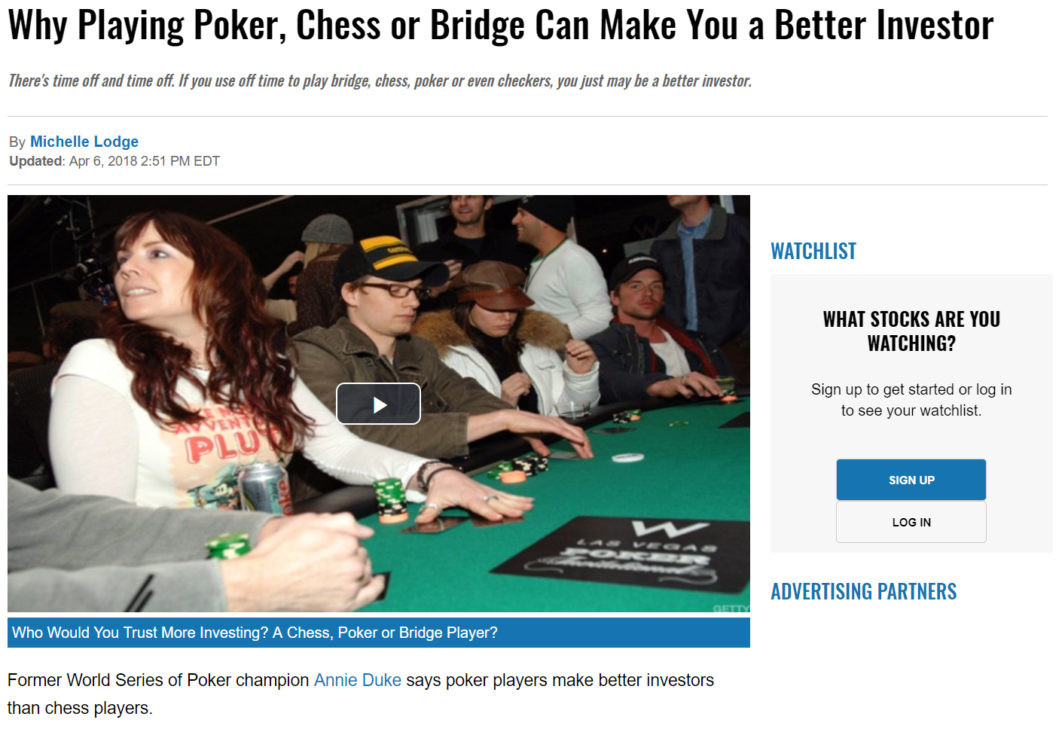
Why poker?
"Investing has a lot of the same features as poker. Poker is a game of incomplete information. In chess, I know where all the pieces are located. In theory, I could calculate all I need to know about chess. With poker, there's still randomness. Bridge lives between poker and chess. In bridge, all the cards are dealt out in the beginning. While you don't know where they are, you can make educated guesses.“ – Kevin Zollman (Game Theory Professor at CMU)

