Slide 1
Sensation Seeking, Sports Cars, and Hedge Funds
Sugata Ray
Univ. of Florida
Joint with Stephen Brown (NYU/Monash), Yan Lu (UCF), and Melvyn Teo (SMU)

Slide 2
“The emerging manager who goes out and buys a fancy sports car right off the bat is someone you probably want to avoid.”
-Business Insider, February 2016

Slide 3
Motivation
Professional fund managers are supposed to take risk to enhance returns, yet some of them may take risk for non pecuniary reasons that have nothing to do with increasing performance.
Sensation seeking is a personality trait defined by the seeking of varied, novel, complex, and intense experiences and the willingness to take physical, social, legal, and financial risks for the sake of such experience.
Sensation seeking has been linked to the propensity to engage in risky driving, extreme sports, substance abuse, and crime (Zuckerman, 1994; 2007)
Sensation seeking CEOs take more business risks (Cain and McKeon, 2016) and generate better innovation outcomes (Sunder, Sunder, and Zhang, 2017). Sensation seeking US households and Finnish retail investors take on riskier housing loans (Bochkay et al. 2017) and trade more often (Grinblatt and Keloharju, 2009), respectively.
Yet little is known about the impact of sensation seeking on important financial participants such as professional fund managers.

Slide 4
Motivation
The hedge fund industry is an interesting laboratory for exploring the impact of sensation seeking on finance.
The complex, dynamic, and relatively unconstrained strategies that hedge funds employ may attract sensation seekers.
The literature has used piloting licenses (Cain and McKeon, JFQA 2016; Sunder, Sunder, and Zhang, JFE 2017), extramarital affairs (Bochkay et al. WP 2017), and speeding tickets (Grinblatt and Keloharju, JF 2009) to identify sensation seekers.
We argue that the purchases of a powerful sports car conveys an intention to drive in a spirited fashion => sensation seeking
We leverage on the characteristics of the vehicles purchased, such as body style, maximum horsepower, maximum torque, passenger volume, and safety ratings to increase the power of our tests.
Vehicle attributes allow us to sidestep concerns about how mileage, enforcement, situational awareness, legal support, radar detectors, and laser jammers can affect probability of citation conditional on speeding
Notes:
Pierre Andurand from Andurand Capital Management (kickboxing), Philippe Jabre of Jabre Capital Partners (alpine skiing), Kah Shin Leow of Quantedge (ultra marathons), and Christian Zugel of Zais Group (automobile racing). Mention Michael Schumacher and Nico Rosberg

Slide 5
Research questions
Do performance car owners take on more investment risk than do non performance car owners? Does the reverse hold for owners of practical but uninspiring cars like minivans
Do performance car owners harvest greater returns as a result of the incremental risk taking?
Does the increased propensity to take risks by performance car owners extend into the operational risk arena?
Do performance car owners exhibit trading behavior that are consistent with sensation seeking, such as a preference for active trading, unconventional strategies, and lottery-like stocks, as well as a propensity for overconfidence?

Slide 6
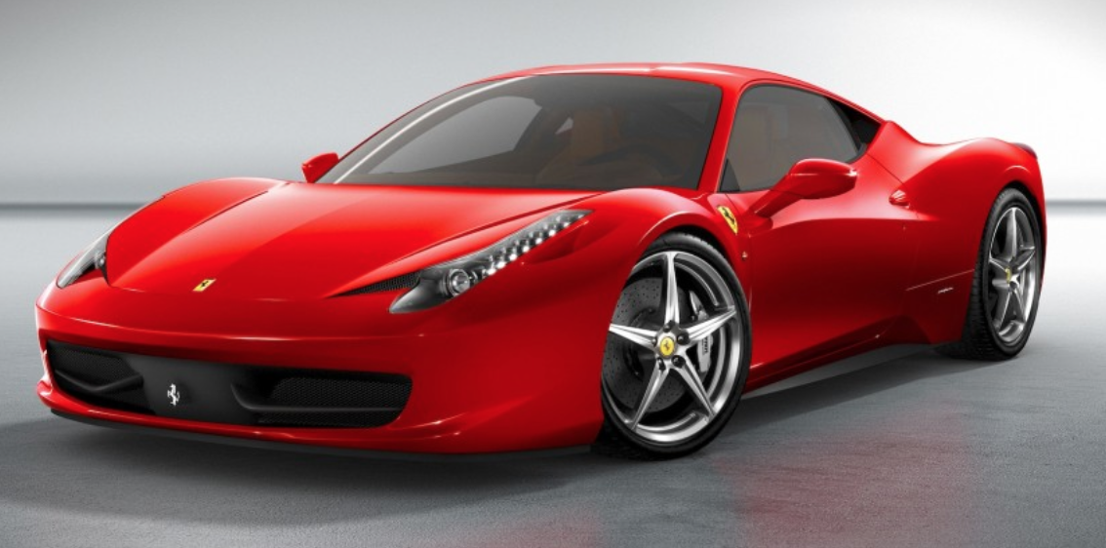
Summary for TLDR types …
== Risky manager … avoid
== Safe manager … good to go

Slide 7
Related literature
Hedge fund financial risks: Systematic risk factors (Mitchell and Pulvino, JF 2001; Agarwal and Naik, RFS 2004; Fung and Hsieh, FAJ 2004). Liquidity risk premium (Sadka, JFE 2010; Teo, JFE 2011). Correlation risk (Buraschi, Kosowski, Trojani, RFS 2014). Macroeconomic risk (Bali, Brown, and Caglayan, JFE 2014).
Hedge fund operational risks: Assessing operational risk and its impact (Brown et al, JF 2008; FAJ 2009; JFE 2012). Predicting hedge fund fraud (Bollen and Pool, RFS 2012; Dimmock and Gerken, JFE 2012).
Corporate finance: CEO military experience (Benmelech and Frydman, JFE 2015), early life experience (Malmendier, Tate, and Yan, JF 2011; Bernile, Bhagwat, and Rau, JF 2017), marital status (Roussanov and Savor, MS 2014) affect corporate outcomes.
Behavioral finance: Overconfidence (Grinblatt and Keloharju, JF 2009; Barber and Odean, JF 2000; QJE 2001). Lottery-like stocks (Kumar, JF 2009; Bali, Cakici, and Whitelaw, JFE 2011). Low volatility anomaly (Baker, Bradley, and Wurgler, FAJ 2011). Genetic factors (Barnea, Cronqvist and Siegel, JFE 2010; Cesarini et al., JF 2010).

Slide 8
Data and methodology
HF data from January 2004 to December 2015. Vehicle data from 2007 to 2012.
Hedge fund data from Lipper Tass, HFR, Morningstar, and BarclayHedge
Hand-collect fund manager vehicle purchase records from website VIN place (vin.place) which features vehicle identification number (VIN), make, model, year data for new cars purchased in the US from dealerships and auto insurance companies.
Additional vehicle information such as trim, body style, horsepower, torque, passenger volume, and safety ratings from Autocheck (www.autocheck.com), cars.com (www.cars.com), cars-data (www.cars-data.com), and IIHS (www.iihs.org)

Slide 9
Data and methodology
We classify cars with the following body styles: “coupe two-door”, “convertible two-door”, and “hatchback two-door” as sports cars
We classify cars with the following body styles: “passenger van”, “sports van”, “extended sports van” as minivans
Pro-sensation attributes include: sports car, maximum horsepower, maximum torque
Anti-sensation attributes include: minivan, passenger volume, and average IIHS safety rating
We are able to match 1,774 vehicles to 1,144 hedge fund managers of which 163 are sports cars and 101 are minivans.

Slide 10
Data and methodology
Table 1: Summary statistics for vehicle attributes

Slide 11
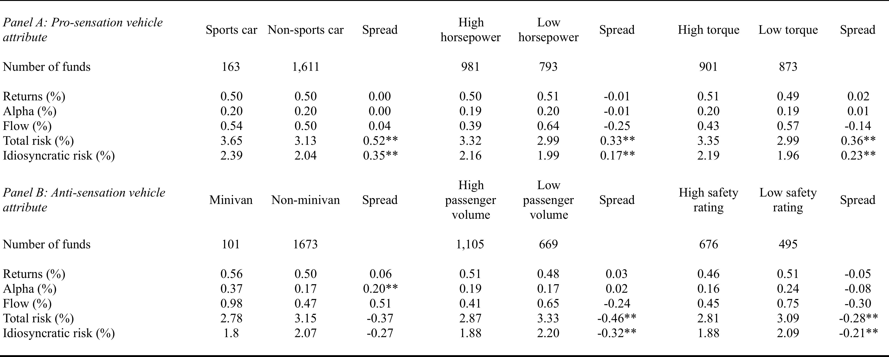
Empirical results: Univariate tests
Table 2: Sorts on hedge fund manager automobile attributes
Notes:
Sports versus non sports = 1.80 percentage points / 16.61 percent, Minivan versus non minivan = 1.28 percentage points / 11.74 percent.

Slide 12
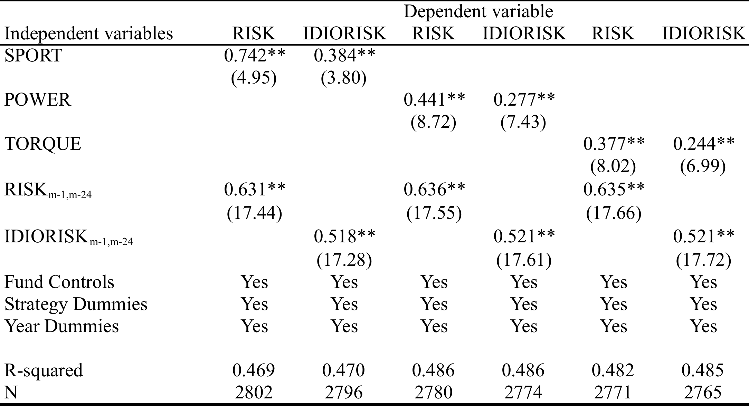
Empirical results: Multivariate tests
Table 3: Multivariate regressions on hedge fund risk with pro-sensation variables
Notes:
Sports versus non sports = 2.57 percent

Slide 13
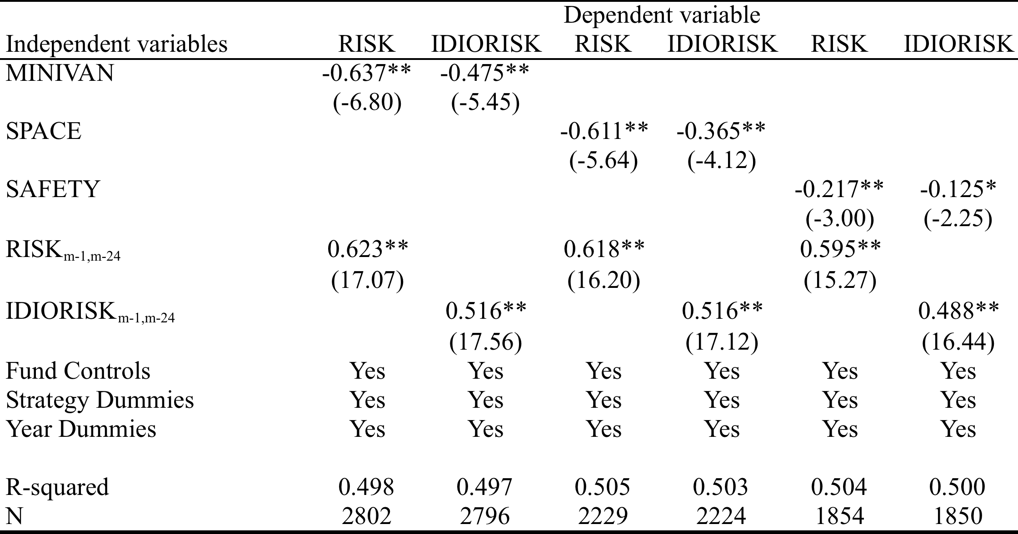
Empirical results: Multivariate tests
Table 4: Multivariate regressions on hedge fund risk with anti-sensation variables
Notes:
Minivan versus non minivan = 2.21 percentage points

Slide 14
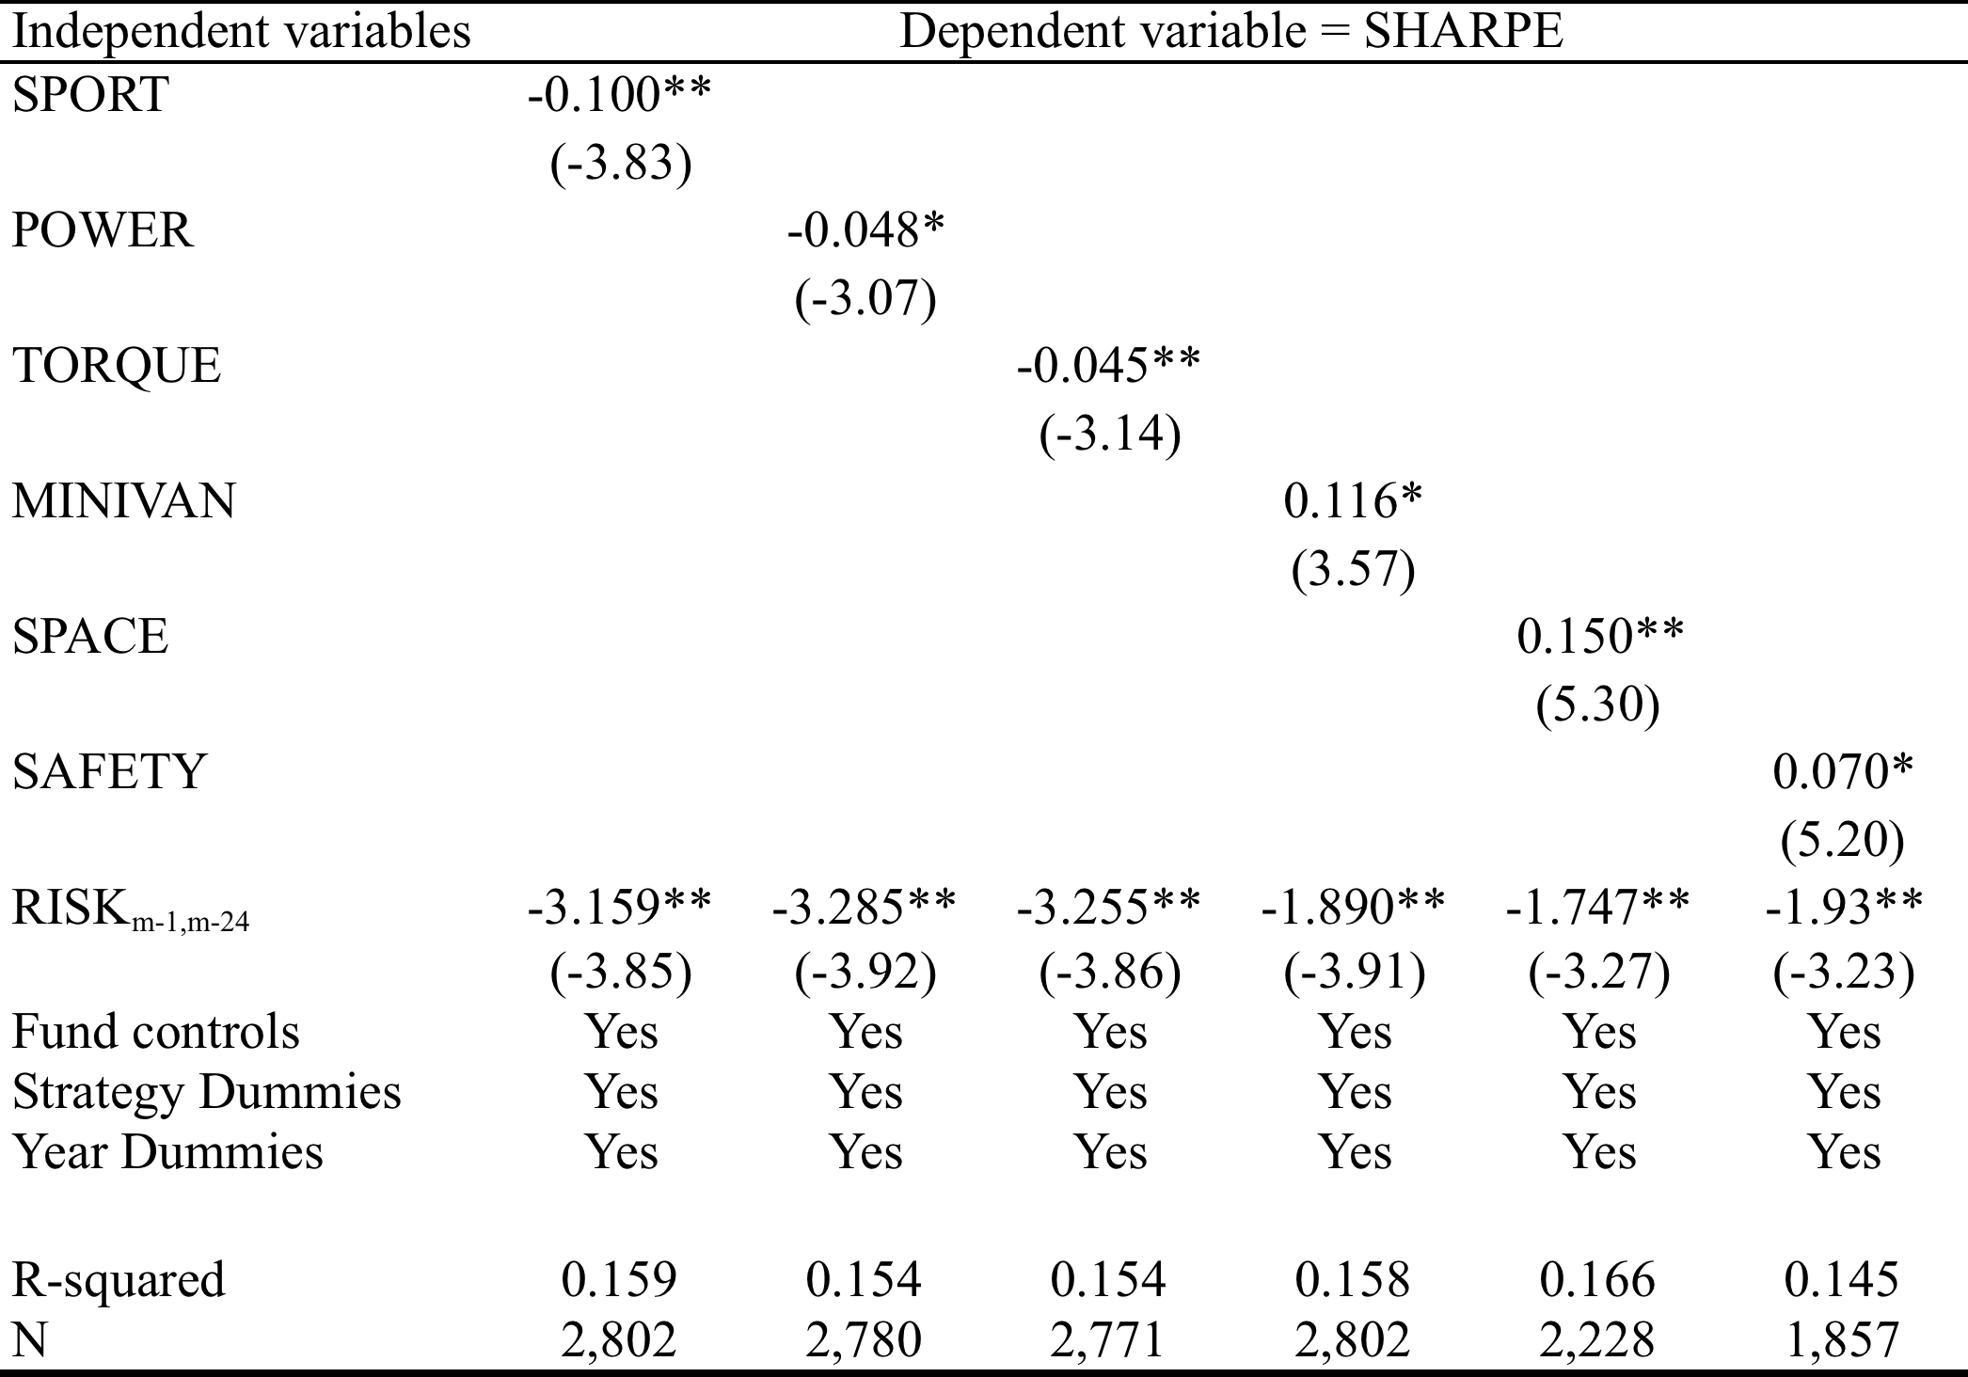
Empirical results: Multivariate tests
Table 5: Multivariate regressions on hedge fund Sharpe ratio
Notes:
Sport = 0.35, Minivan = 0.40, Mean = 0.84, Std = 1.15

Slide 15
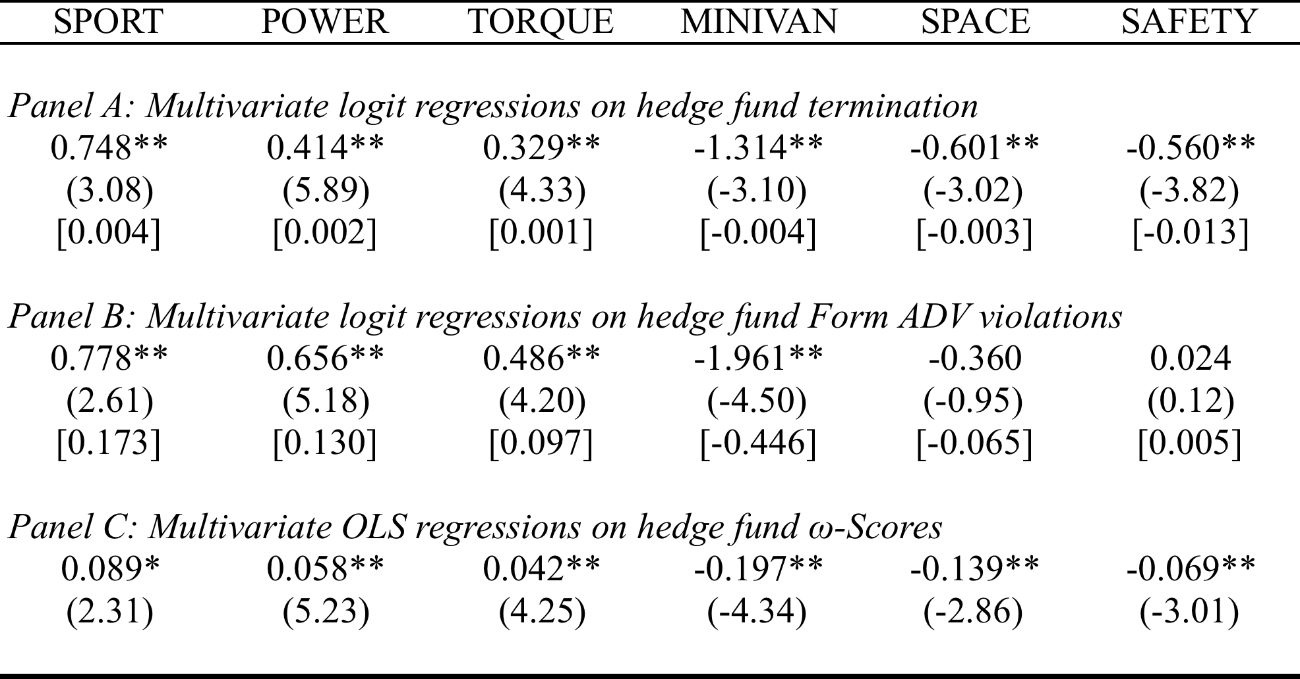
Empirical results: Multivariate tests
Table 6: Multivariate regressions on hedge fund operational risk metrics
Performance car drivers more likely to experience fund termination
Performance car drivers more likely to have ADV violations and have higher ω-scores (both measure operational risk)
Conversely, minivan/safe car drivers less likely to experience fund termination; demonstrate lower operational risk
Notes:
Sports = 4.70 percent more likely to terminate in any given year. Unconditional = 6.04 percent per year. Regulatory, civil and criminal violations. Sports car owners 17 percentage points more likely to violate. Omega std = 1.22

Slide 16
Empirical results: Trading behavior
Table 7: Trading behavior analysis
Performance car drivers trade more. The trades they make leave them worse off than not trading. Opposite for practical car drivers.
Performance car drivers are less aligned with index and have higher active shares. They are also less aligned with their hedge fund strategies. Opposite true for practical car drivers.
Performance car drivers own more “lottery-like” stocks. Practical car owners own less.
Notes:
Kumar (2009) definition: low priced, high idiosyncratic vol, high idiosyncratic skew. MAX = maximum daily return over the past month.

Slide 17
Empirical results: Alternative explanations
Reverse causality – driving performance cars lead managers to take on more risk
Gender – men purchase sports cars, women purchase minivans
Social status/wealth – driven by greed, higher status drivers exhibit unethical behavior, greed drives risk.
Marital status – single men purchase sports cars, married men purchase minivans
Manager age – older managers do not purchase sports cars
Sample selection – risk taking managers who succeed buy new cars
Endogeneity –risk taking managers who succeed buy sports cars … we don’t observe failures
Marketing – Managers actually buy sports cars to get flows
Notes:
8.74 percent of the managers are female. Managers who choose to purchase new cars may have taken greater risks and have been more successful at parlaying risk into returns.

Slide 18
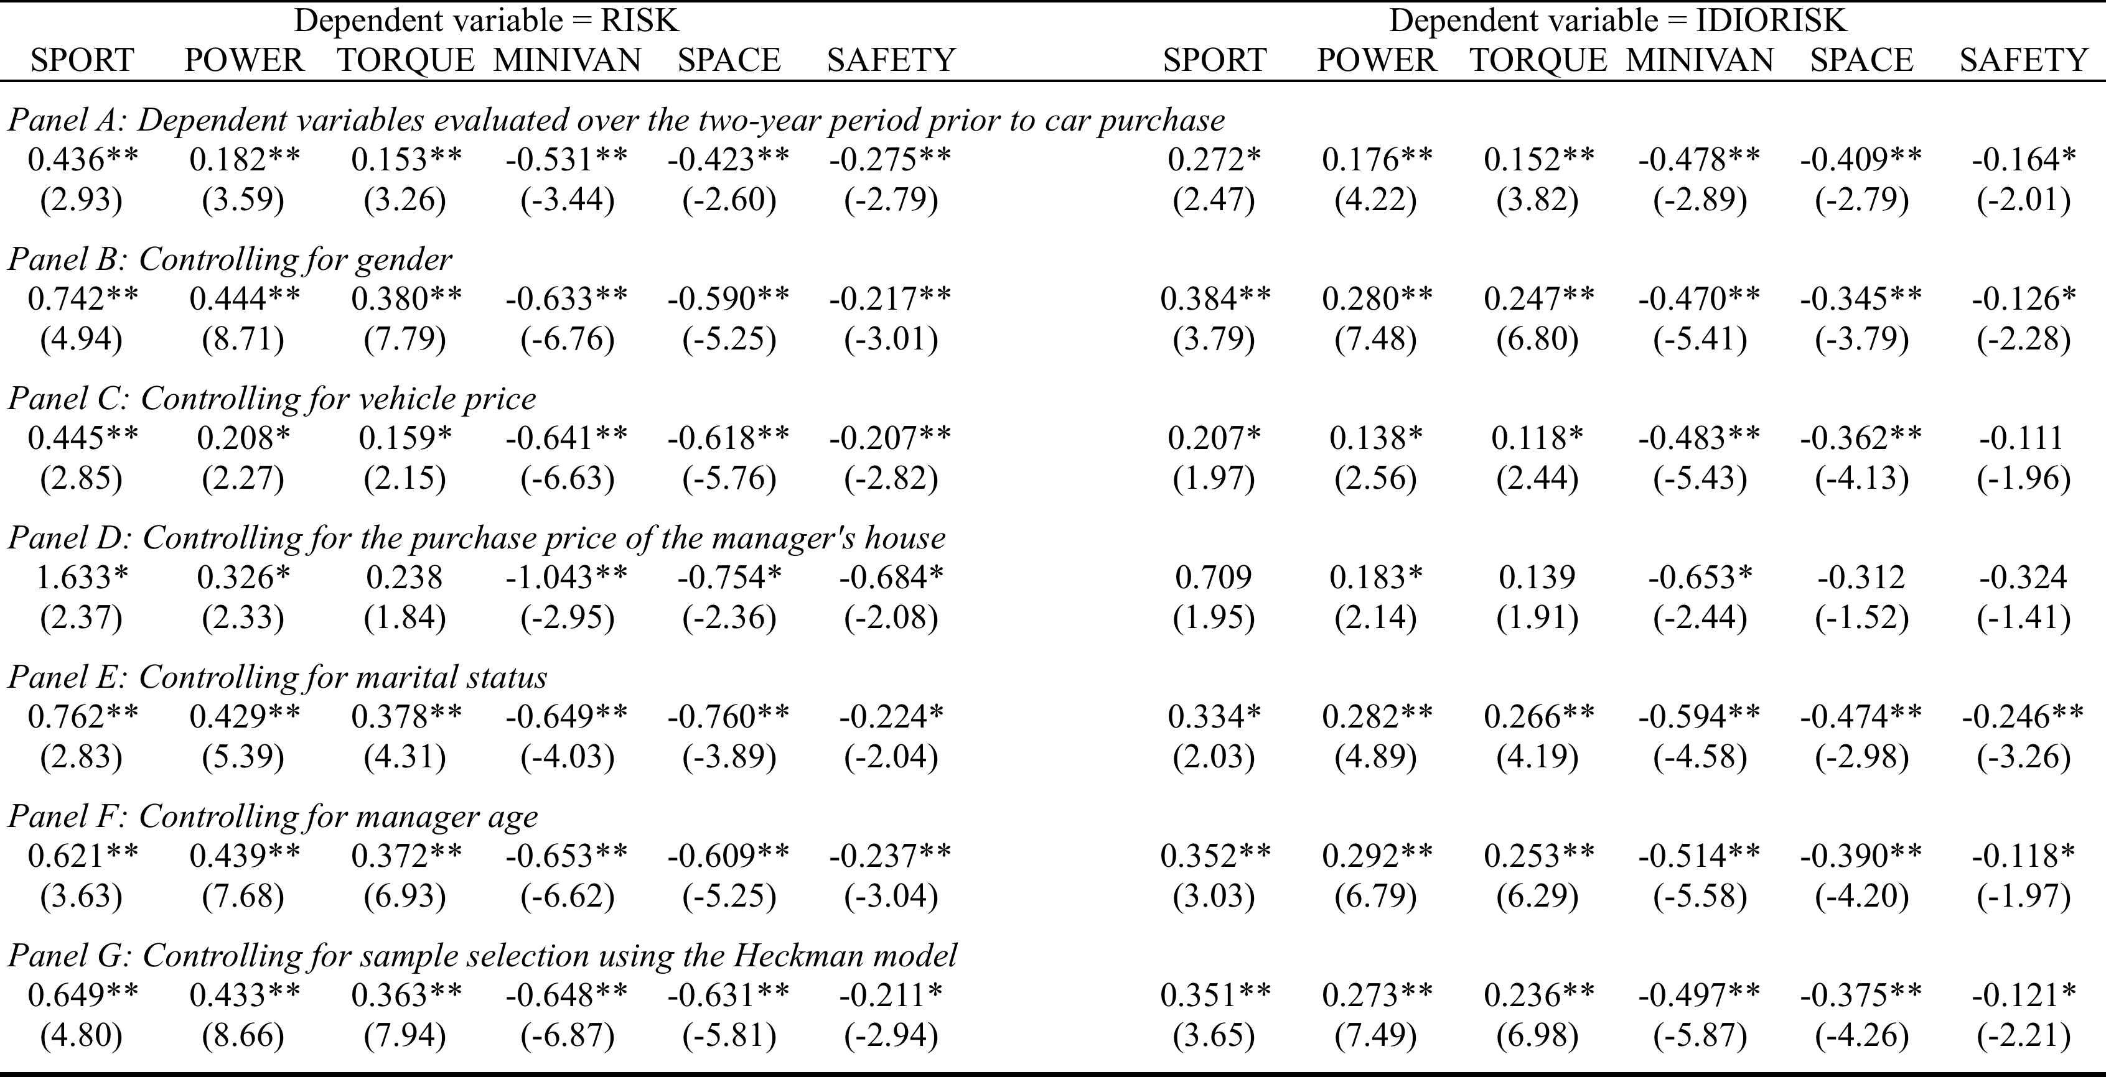
Empirical results: Alternative explanations
Table 8: Accounting for alternative explanations
Notes:
Negative inverse mills ratio => hedge funds that purchased new cars subsequently took less risk.

Slide 19
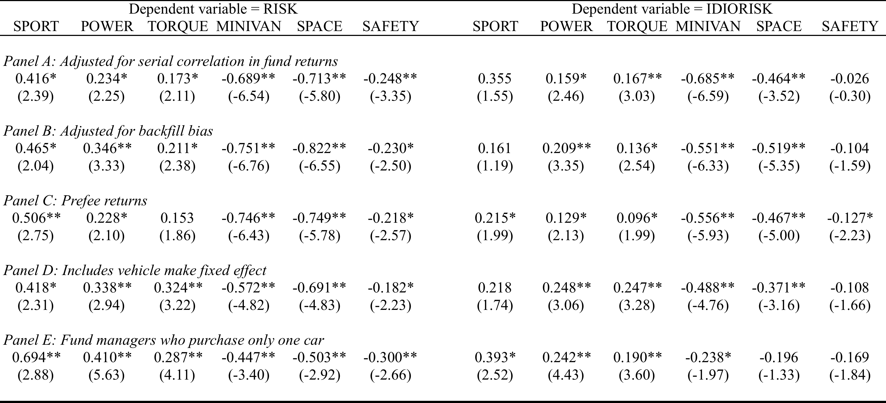
Empirical results: Robustness tests
Table 9: Robustness tests
Notes:
Serial correlation: Minivan owners own more illiquid securities than do sports car owners.
Backfill: Minivan owners backfill their returns more often than do sports car owners
Vehicle make: BMW drivers take more risk than do Volvo drivers

Slide 20
Conclusions
Hedge fund managers who own high performance cars take on more investment risk than do hedge fund managers who eschew such cars.
They do so without being compensated for with higher returns. Performance car owners deliver lower Sharpe ratios than do other car owners.
The incremental risk taking by sports car owners extends beyond the financial markets arena into operational risk space as well. Performance car buyers are more likely to terminate their funds, report violations on their Form ADVs, and exhibit higher ω-Scores.
Sensation seeking impacts hedge fund manager trading behavior. Hedge fund managers who embrace sports cars trade more frequently, actively, and unconventionally. They are also more prone to overconfidence and prefer lottery-like stocks.
Our paper provides a starting point for understanding the implications of personal lifestyle choices on investment management and empirically validate advice given by some allocators to avoid hedge fund managers who purchase fancy sports cars.
Notes:
Despite importance of sensation seeking to finance (CEOs, retail investors, households).
Despite importance of sensation seeking as a possible driver of non pecuniary risk taking and prevalence of sensation seeking behavior amongst professional fund managers
Evidence that relates sensation seeking to investment behavior of professional fund managers has remained elusive.
Novel dataset, purchase sports cars signal intent.
Extend to the study of other asset managers e.g., mutual funds, venture capital, private equity. Extend to the study of entrepreneurs.

