Slide 1
Limited Attention, Marital Events, and Hedge Funds
Sugata Ray
Joint work with Yan Lu (UCF) and Melvyn Teo (SMU)

Slide 2
“Almost a quarter of British motorists admit that they have been so distracted by roadside billboards of semi-naked models that they have dangerously veered out of their lanes .”
-Reuters (London) 21 November 2005

Slide 3
Motivation: Limited attention on limited attention
There has been limited attention on the topic of limited attention.
Research has shown that limited attention can cause market participants to
  underreact to earnings announcements (Hirshshleifer, Lim, and Teoh, JF 2009; DellaVigna and Pollet, JF 2009)
  purchase top volume stocks (Barber and Odean, RFS 2008)
  neglect economic links between consumer and supplier firms (Cohen and Frazzini, JF 2008)
  gloss over longer term demographic data (DellaVigna and Pollet, AER 2007)
However, the extant literature has yet to show the impact of limited attention on investment performance.

Slide 4
“One of my No. 1 rules as an investor is as soon as I find out that a manager is going through divorce, I redeem immediately. Because the emotional distraction that comes from divorce is so overwhelming. … You can automatically subtract 10 to 20 percent from any manager if he is going through divorce.””
-Paul Tudor Jones II, May 2013

Slide 5
Motivation
Anecdotal evidence suggests that hedge fund investors value a fund manager’s ability to stay focused in the investment game.
Funds managers take to extreme measures to focus (e.g. Ray Dalio meditates; SAC (now Point72) had an on-staff psychiatrist)
Divorces and marriages are intense personal events, taking away from attention and focus at work
We test the importance to investment management of the ability to stay focused by analyzing the impact of marital events on hedge fund manager performance.

Slide 6
Research questions
How do marital events such as getting married or getting divorced impact the investment performance of hedge fund managers?
Are busier managers affected more?
What are the channels of performance impacts? (previewing the results, how do distracted managers destroy value?)

Slide 7
Related literature
Division of labor in marriage increases productivity: Becker (JPE 1973), Korenman and Neumark (JHR 1991), Cornaglia and Feldman (WP 2011), and Bellas and Toutkoushian (RHE 1999)
Limited attention and earnings: e.g. Hirshsleifer, Lim, and Teoh (JF 2009) - Earnings announcements crowded out by other announcements, DellaVigna and Pollet (JF 2009) - Friday Earnings announcements
Active fund management: e.g. Cremers and Petajisto (RFS 2009)
Hedge fund performance: e.g. Teo (RFS 2009), Daniel, Naik, and Agarwal (JF 2009), Bollen and Poole (JFQA 2008, JF 2009).
“Limited attention” and corporate finance: e.g. CEO vacation travel (Yermack, JFE 2014), CEO family deaths (Bennedsen, Perez-Gonzalez, and Wolfenzon, WP 2010), CEO hospitalizations (Bennedsen, Perez-Gonzalez, and Wolfenzon, WP 2012)

Slide 8
Data and methodology
Sample period from January 1994 to December 2012
Hedge fund performance data are from TASS, Morningstar, HFR, and Barclay Hedge. After removing duplicate share classes we have 26,811 funds of which 15,550 are live and 11,261 are dead.
Hedge fund manager marital records from Lexis-Nexis court searches, supplemented by other internet sources. Records are publicly available for 13 U.S. states.
We observe 857 marriages and 251 divorces for 786 hedge fund managers.
Hedge fund holdings data from Thomson Financial 13-F filings data for fund families with at least US$100m of long U.S. equity holdings

Slide 9
Data and methodology
Figure 1: Distribution of marriages across our sample of U.S. states (1994-2012)
13 states publicly disclose marital records. The remaining states do not disclose marriage and divorce data publicly. For example, New York State restricts access to marriage records to “the spouses [and] other persons who have a:
(1) documented judicial or other proper purpose or (2) New York State Court Order.”
Notes:
857 marriages, 251 divorces, 786 hedge fund managers

Slide 10
Data and methodology
Figure 2: Distribution of divorces across our sample of U.S. states (1994-2012)

Slide 11
Data and methodology
We adopt an event study framework to analyze the impact of marital events on fund manager performance
Our event window starts 3 months before and ends 3 months after the date of the marital event. The pre-event window starts 2 years prior to the event and ends 3 months before the event. The post-event window starts 3 months after the event and ends 2 years after the event.
We adjust for risk using the Fung and Hsieh (FAJ 2004) seven-factor model and using the past 24 months of fund returns to generate rolling betas.
We employ multivariate regressions that control for size (Berk and Green, JPE 2004), redemption terms (Aragon, JFE 2007), incentive fees (Agarwal, Daniel, and Naik, JF 2009), and fund age (Aggarwal and Jorion, JFE 2010)

Slide 12
Data and methodology cont’d
To control for endogeneity concerns, we also perform a matched sample analysis
Each fund in the treatment group is matched with a fund in the control group by minimizing the absolute difference in performance during the "Before" period.
Example of endogeneity concern:
  Fund does well, manager gets married because fiance/fiancee is excited about good performance/fees, performance mean reverts
Matched sample avoids this, since post marriage performance will be compared to another fund that does well, but where the manager doesn’t get married

Slide 13
Empirical results: Univariate results
[event study-marriage]

Slide 14
Empirical results: Univariate results
[event study-divorce]

Slide 15
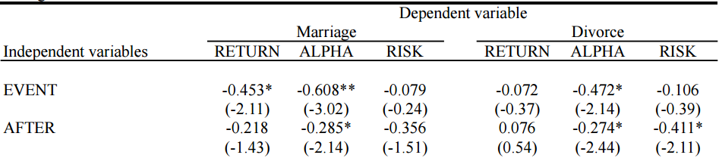
Empirical results: Multivariate results [event study]
Table 4: Multivariate regression analysis
Sample includes marrying/divorcing funds and other funds in the states for which we have data
Results displayed are monthly – so marrying fund managers underperform matched peers by 0.61% (or about 7.3% annualized alpha) during the 6 months around the marriage
Basically – both marriages and divorces are bad for fund alpha

Slide 16
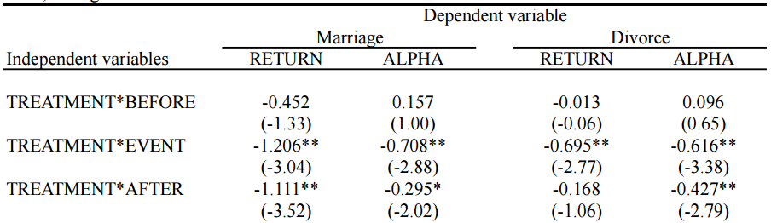
Empirical results: Multivariate results [matched sample]
Table 5: Multivariate regression analysis with matched sample
Sample includes marrying/divorcing funds and matched sample of funds, that are matched based on past performance
Results displayed are monthly – so marrying fund managers underperform matched peers by 0.71% (or about 8.5% annualized alpha) during the 6 months around the marriage
Again – both marriages and divorces are bad for fund alpha

Slide 17
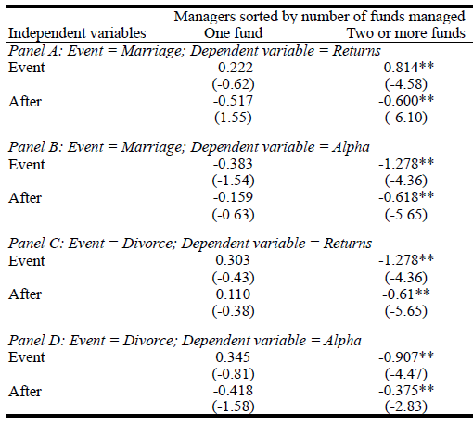
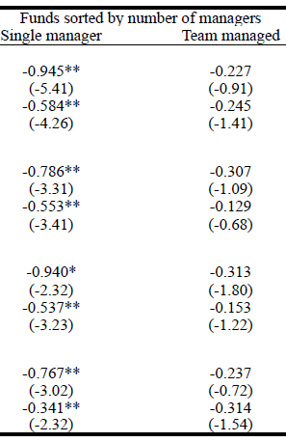
Busy managers affected more … suggests limited attention pays a role
Table 6: Regressions on performance for fund managers sorted by manager bandwidth
Notes:
Indicators of manager bandwidth are correlated with the emotional impact of divorce

Slide 18
Recap and next steps
So it looks like marriages and divorces lead to worse performance, during and after the event
This underperformance is worse for busier managers, suggesting distractions due to limited attention are responsible
But, why does performance decrease?

Slide 19

Coasting
When you’re distracted, you reduce attention and keep doing the default
Less active management; more index hugging, factor following
What happens? The coffee spills… aka… performance decreases

Slide 20
Susceptibility to behavioral biases
When you’re distracted, you reduce attention and are more prone to biases common to humans
We test for disposition effect, but other biases may also be at work
  Disposition effect is tendency to want to realize gains and hold losses (Odean (1998))

Slide 21
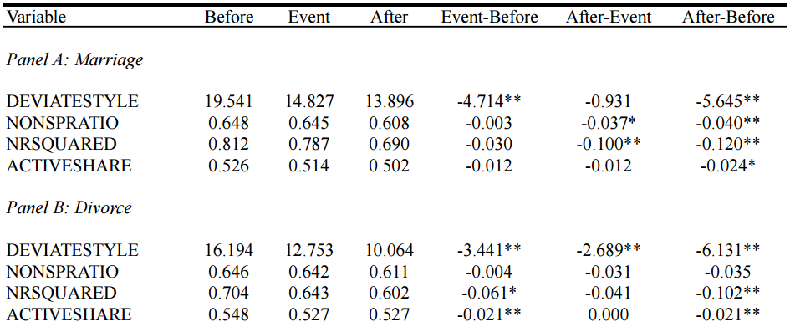
Coasting evidence
Table 7: Style, index, and factor exposure analysis
Marrying and divorcing fund managers …
…. during and after their marital events
Have higher R-squareds from 7-factor regressions
follow their HF fund category styles more closely
Decrease their active share measure (Cremers and Petajisto (2009))
choose S&P index constituents as their new holdings

Slide 22
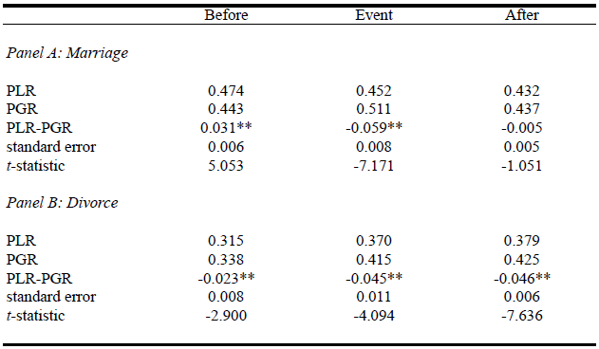
Susceptibility to disposition effect
Table 8: The disposition effect around marital events
Managers become more prone to the disposition effect during marriage and divorce. The effect persists after the divorce.

Slide 23

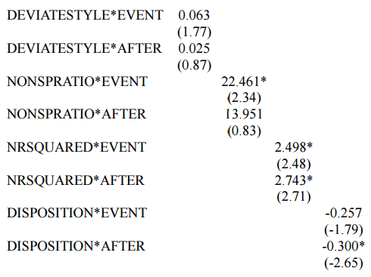
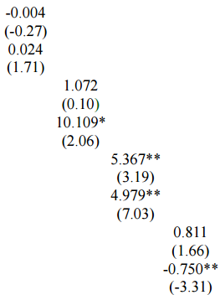
These channels (decreased active mgmt., higher disposition effect) are associated with underperformance
Table 8: Regressions on hedge fund performance with interaction variables
Marriage
Divorce

Slide 24
Empirical results: Alternative explanations
Poor hedge fund performance can engender marital distress which results in divorce. Poor performance may persist post divorce (Kowoski, Naik, and Teo, JFE 2007)
Prescient spouses of hedge fund managers may foresee a bad patch of returns and preemptively file for divorce so as to maximize their financial return [but not other way around?]
In order to minimize the size of matrimonial assets that has to be divided up during a divorce, hedge fund managers may misreport returns (Bollen and Poole, JFQA 2008; JF 2009) understate performance post marriage and overstate performance pre marriage.

Slide 25
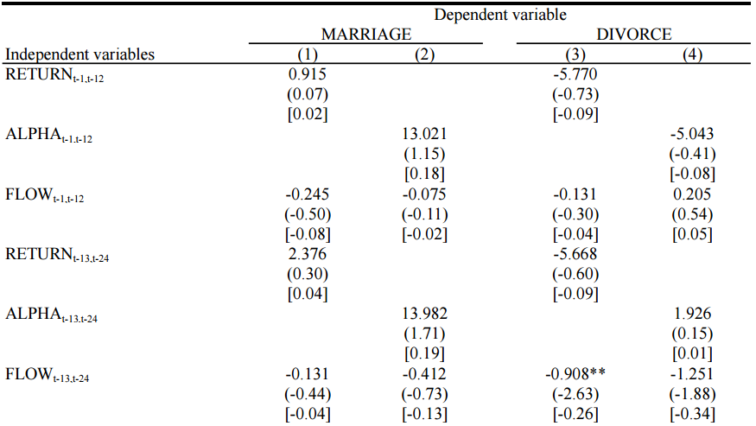
Empirical results: Alternative explanations
Table 10: Regressions on the probability of marriage and divorce amongst hedge fund managers
Doesn’t look like a whole lot of predictive power – especially with recent performance numbers
That being said, we do matched sample to avoid issues

Slide 26

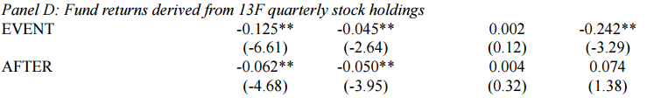
Empirical results: Alternative explanations
Table 11: Fund returns derived from 13F stock holdings
Unlikely to be smoothing, since holdings data shows similar pattern

Slide 27
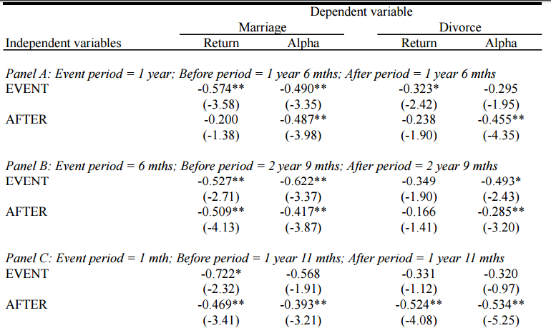
Empirical results: Robustness tests
Table 11: Alternative event windows

Slide 28
Conclusions
We document the impact of limited attention on investment performance.
We show that fund investment performance deteriorates significantly during and following a marital event.
Busier managers and those without backup are most susceptible to this underperformance
Two potential mechanisms contributing to the poor performance include
  Coasting - sticking to default (i.e. everyone else’s or index-based) strategies
  Increased susceptibility to behavioral bias

